Slide 1
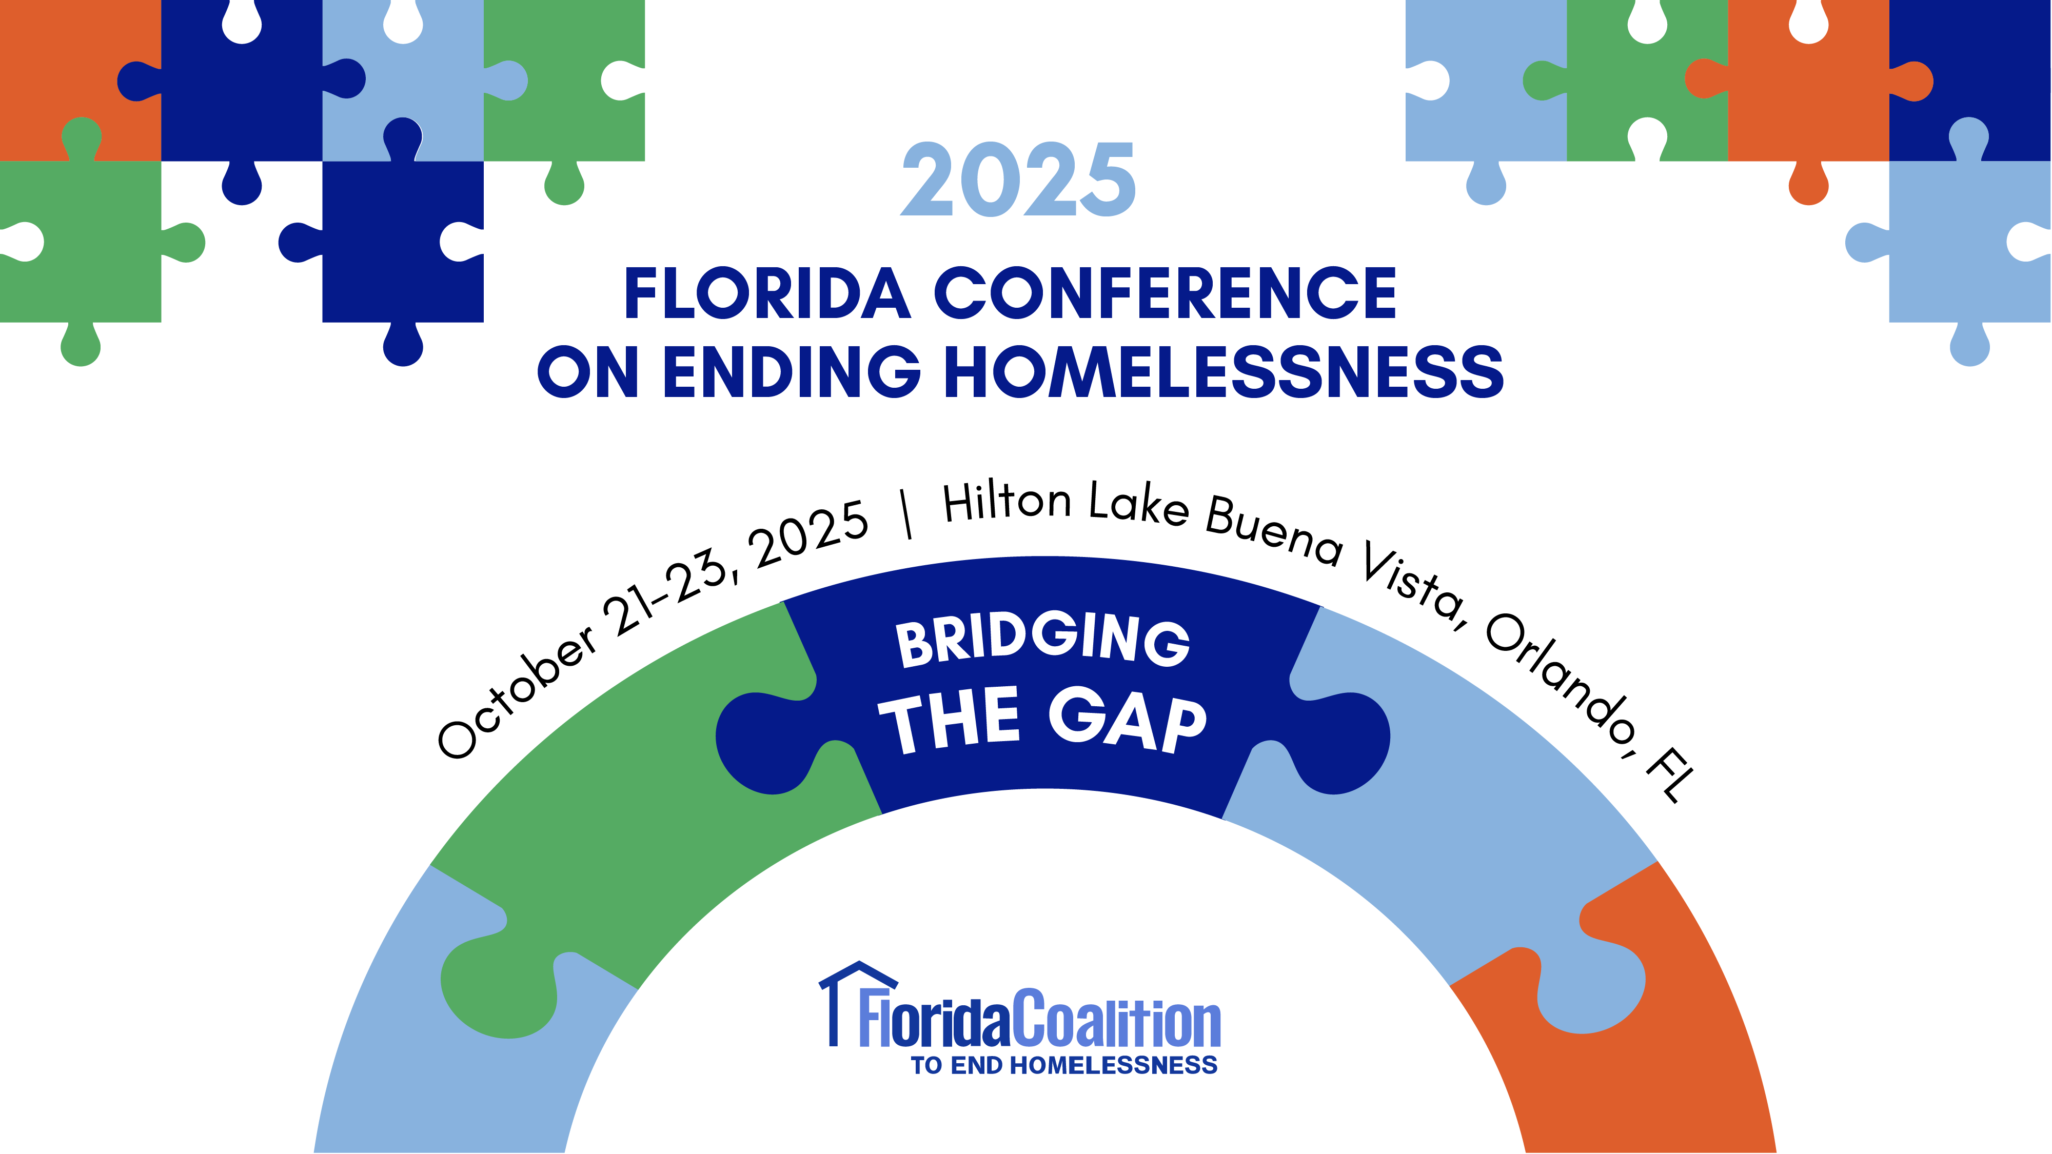

Slide 2
From Raw Data to Real Impact: Using Visualizations to Drive Homeless System Change
Presented by Gaither Stephens
Notes:
Welcome, and thank you for being here. Today we’ll look at homelessness not as individual failure, but as the product of interacting systems—housing markets, wages, health, justice, and policy. Data reveals patterns; systems thinking explains why they repeat. My goal is to connect empathy with evidence so we can design what works in practice. By the end, you’ll see why Housing First isn’t just compassionate—it’s structurally sound. It reduces churn, improves outcomes, and aligns with how real systems behave. If we learn to see flow, feedback, and leverage, we can stop arguing over snapshots and start changing the system that produces them.
###END OF NOTE###

Slide 3
Agenda
01
02
03
04
Who is Gaither Stephens?
Why Housing First?
What is Systems Thinking?
Where Do We Go From Here?
05
How is it going? (Questions/Comments)
06
Thank You!
Notes:
Here’s the roadmap for today. I’ll start with how I came into this work, then introduce systems thinking and how it reshapes what we notice and measure. We’ll connect those ideas to Housing First, review what the evidence shows, and then move into system flow—stock, inflow, outflow, and the feedback loops that drive change. Finally, we’ll end with concrete steps your community can start tomorrow. The goal is to move from good intentions to good design—using data as a feedback instrument, not a scoreboard—so our efforts compound instead of recycle.
###END OF NOTE###

Slide 4
Introduction
Homelessness is complex and touches every community
Data reveals patterns beyond single stories
Systems thinking shows flows in and out of homelessness
Together, they point to solutions like Housing First
Better data, used well, can change lives
Notes:
Homelessness is complex, and stories alone can’t explain why it persists. Data shows patterns; systems thinking shows why those patterns repeat. It reveals the flows in and out of homelessness and where our interventions help or harm. When we combine Housing First with a systems lens, it stops being a philosophy and becomes a design principle: stabilize first, then support. That simple shift turns chaos into a system we can manage. This isn’t about blame—it’s about understanding pressure, rhythm, and leverage so we intervene where change lasts.
***END OF NOTE***

Slide 5
01
Who Is Gaither Stephens?
CEO | National Speaker | Data Scientist | Board Member
Notes:
This section frames who I am and why I care, because systems work is both technical and human. My background is in radio operations—seven stations across three states—which taught me flow, dependencies, and what happens when one link breaks. I later studied information systems, business, and data management, which gave me tools to turn complexity into clarity. Today, I help communities visualize their homelessness systems clearly enough to change them. It’s the same operational rigor required to run a network of stations, applied to a network of programs. If we can see the system together, we can align it together.
###END OF NOTE###

Slide 6

Gaither Stephens
The Early Years
Early Career
Nearly 20 years managing 7 radio stations across 3 states
Managed 50+ staff across multiple offices and studios
Education
AS – Information Systems, Purdue University
BS – Business Administration, Indiana Wesleyan
MS – Database Management & Business Intelligence, Boston University
Notes:
I spent twenty years managing radio stations, where I learned how systems fail when one link breaks. Later, data and business training gave me the tools to turn complexity into clarity. Now, I apply that same operational discipline to homelessness systems. The lesson is universal: when we can see the system together, we can align it together. Different industry, same principle—flow, coordination, and design.
###END OF NOTE###

Slide 7

Gaither Stephens
Work in Homelessness
Charlotte County Homeless Coalition
  Data Analyst Board Member
  Gulf Coast Partnership Chief Technology Officer
Gaither Dynamic
  CEO – built dashboards for 60+ communities
CoC Alliance
  Founder/President
NHSDC, FCEH, FHC, PCHO
  National Presenter
Notes:
I started as a data analyst, became a CoC CTO, and now build dashboards nationwide. The work is personal—my son is currently experiencing homelessness in LA. That reminds me: accuracy isn't just statistical, it's moral. Systems must learn and stop repeating failures.
***END OF NOTE***

Slide 8

Charlotte County Homeless Coalition Staff Photo 2016
Gaither
Notes:
In those early years as data analyst for the Charlotte County Homeless Coalition in Port Charlotte, Florida, I wore a lot of hats and learned from great people doing the work. As a data analyst and later CTO of the local CoC and HMIS lead, I managed HMIS operations and data quality; ran the Point-in-Time Count; produced all local, state, and federal reports; and supported veteran and chronic homelessness case-conferencing teams so we could move people by name. I also handled the unglamorous essentials—IT support, network and security, website and graphic design—because getting the data right and communicating it well is part of client care. That breadth matters: while overwhelming at times, it grounded me in the day-to-day realities behind the numbers and taught me how systems truly function in the field.
###END OF NOTE###

Slide 9

Charlotte County Homeless Coalition Board Photo 2024
Gaither
Notes:
Serving on the board taught me a simple truth: systems don't change in silos. Progress happens when data teams, providers, and policymakers see the same picture. That alignment is what turns good programs into good systems.
###END OF NOTE###

Slide 10
Why Housing First?
Because Stability Is the Starting Line, Not the Reward
Notes:
For decades, our system was built on rules—curfews, sobriety, compliance milestones. The idea was that people had to prove readiness for housing. But the cracks showed fast: you could follow every rule and still fall through. Data told a different story. Communities that housed first, then offered voluntary services, achieved better outcomes at lower cost. Housing First marked a turning point—from enforcing steps to creating stability, from deciding who’s deserving to designing systems that work.
###END OF NOTE###

Slide 11









The Old Way of Thinking
The Stairway to Success (with lots of ways to fall off)!
Permanent
Housing
Transitional
Housing
Shelter
Placement
Homeless
Notes:
This was the old model—the “stairway to success.” The logic was simple: climb the steps—get sober, find work, complete treatment—and earn housing. Each step came with conditions: sobriety, curfews, mandatory check-ins, employment rules. But look closely—each is another place to fall off. For people already struggling with trauma or poverty, this wasn’t a path upward. It was an obstacle course that rewarded luck, not readiness.
###END OF NOTE###

Slide 12



Why It Failed
It wasn’t a staircase – it was a stress test…on already stressed people!
Sobriety requirements
Curfews and mandatory check-ins
Program compliance
Employment or income rules
Mandatory treatment or medication
Case plan completion
“Readiness” evaluations
Permanent
Housing
Transitional
Housing
Shelter
Placement
Homeless
Notes:
The old system failed because it was built on the wrong assumptions. It assumed homelessness was about bad choices—that if people just followed the steps, they’d reach stability. But people entering these programs were already carrying enormous pressure: trauma, poverty, mental illness, addiction. The system added more on top. Those cracks in the staircase? That’s where people fell through—not because they didn’t try, but because the structure itself was unstable. It wasn’t a staircase to success; it was a stress test that almost no one could pass.
###END OF NOTE###

Slide 13







Leaping Over Barriers
When we stopped climbing stairs and started moving forward
Housing
First
Permanent
Housing
Transitional
Housing
Shelter
Placement
Homeless
Notes:
Instead of climbing a staircase full of rules, what if we just jumped over it? What if stability—a safe, secure place to live—came first? That’s Housing First. Instead of making people prove readiness for housing, we give them housing first and surround them with the support they need to stay there. It replaces judgment with evidence and obstacles with opportunity. It’s not about skipping accountability—it’s about reordering the approach so people can rebuild, not climb. Housing First provides a foundation for recovery instead of a staircase to nowhere.
###END OF NOTE###

Slide 14
What is Housing First?
A foundation, not a finish line
Immediate access to housing without preconditions
Client choice and self-determination
Harm reduction, not abstinence enforcement
Supportive services are voluntary but available
Integration into the community
Focus on recovery and long-term stability
Notes:
Housing First has been proven for over two decades. HUD studies show 85–90% housing retention rates. In Sam Tsemberis’s Pathways to Housing study, nearly nine out of ten people were still housed five years later. Health outcomes improved—emergency room visits and jail stays dropped by half. Financially, communities saved $9,000 to $30,000 per person each year. Housing First isn’t just compassionate—it’s evidence-based design that improves lives, reduces costs, and strengthens systems. Stability first doesn’t just work; it changes everything.
###END OF NOTE###
https://nlihc.org/sites/default/files/Housing-First-Research.pdf
https://en.wikipedia.org/wiki/Pathways_to_Housing
https://docs.huduser.gov/archives/portal/publications/pdf/hsgfirst.pdf
https://pmc.ncbi.nlm.nih.gov/articles/PMC7518819/

Slide 15
The Results
Compassion backed by evidence
✅ 85–90% housing retention — across multiple Housing First programs
✅ 50% reduction in ER visits and jail stays — compared to traditional models
✅ 30–40% lower public costs per person — from reduced emergency and institutional use
Notes:
Housing First is a simple idea with profound results. It says that housing isn’t something you earn — it’s where recovery begins. It removes preconditions like sobriety, employment, or treatment completion and replaces them with respect and support.
People are offered housing right away, along with voluntary services to help them rebuild. It’s not housing-only — it’s housing as a foundation for stability, dignity, and choice.
And the data backs it up. When people have a safe place to live first, everything else — treatment, employment, recovery — becomes far more achievable. Housing doesn’t just end homelessness; it creates the conditions where positive permanent change is finally possible.
###END OF NOTE###

Slide 16

The Human Impact
Behind every data point is a person
“This is home to me. It’s a community here. I don’t know where I would be if it weren’t for this place.”
-Dawn Wade
https://www.pressherald.com/2023/04/23/ambitious-plan-to-end-chronic-homelessness-embraces-housing-first-strategy/
Notes:
This is Dawn Wade. She lives in one of Maine’s Housing First communities. When asked about her home, she said, “This is home to me. It’s a community here. I don’t know where I’d be without it.” That’s the real outcome—not just retention rates or cost savings, but stability, belonging, and dignity. When people move from surviving to living, everything changes—health, relationships, hope. Each data point we see represents someone like Dawn who just needed the system to give them a fair start and a foundation to rebuild.
###END OF NOTE###

Slide 17
02
What is Systems Thinking?
Deep dive into the differences between mental models and system models
Notes:
Now that we’ve seen how Housing First changes outcomes, let’s zoom out even further. Up to this point, we’ve focused on programs and results. Now we’ll look at how systems behave. Systems thinking is like putting on new glasses—it helps us see homelessness not as isolated people or projects but as movement: people flowing in and out due to pressures, barriers, and supports. Once you see that flow, you can’t unsee it. The numbers we track aren’t just counts—they’re signals of how the system is performing.
###END OF NOTE###

Slide 18

“Systems thinking is a discipline for seeing wholes. It is a framework for seeing interrelationships rather than things, for seeing ‘patterns of change’ rather than ‘static snapshots.”
- Peter Senge
Notes:
Systems thinking teaches us to see relationships instead of parts—and change over time instead of snapshots. When we only look at static numbers, like the Point-in-Time Count, we’re seeing a single frame of a movie. It tells us how many people are homeless, but not why or how that number shifts. Systems thinking lets us step back and watch the whole film—to see causes, pressures, and feedback loops. Once we start seeing those patterns, we can design smarter, lasting solutions instead of reacting to the moment.
###END OF NOTE###

Slide 19
Framing Matters: Mental Models vs. System Models
Mental Models
System Models
Shortcuts shaped by assumptions and experience
Useful for quick thinking but misleading when problems are complex
Risky for policy decisions
Structured way of mapping connections and outcomes over time
Use data feedback loops and cause-and-effect to reveal patterns mental models miss
Strong for long-term solutions
Notes:
How we frame a problem determines how we solve it. A mental model relies on assumptions and quick judgments—useful for small issues, dangerous for complex ones. In homelessness, that model says the problem lies within individuals: they need to work harder, get sober, follow rules. A system model zooms out to show relationships and feedback loops—the forces shaping outcomes. When we shift from “What’s wrong with this person?” to “What’s wrong with the system producing this result?” everything about our response changes.
###END OF NOTE###

Slide 20
3 Examples of Mental Models
Traffic Improvements
Forest Fires
Antibiotic Use
Mental Model: Add lanes to reduce congestion
Unintended Outcome: More lanes attract more cars, making congestion worse
Mental Model: Put out every fire to keep forests safe
Unintended Outcome: Fuel builds up, leading to catastrophic megafires
Mental Model: Prescribe antibiotics widely to cure infections
Unintended Outcome: Overuse drives resistance, creating “superbugs”
Notes:
Let’s look at how mental models fail. Traffic? Add more lanes to reduce congestion—and it gets worse. Forest fires? Stop all burns—and fuel builds until a megafire erupts. Antibiotics? Overprescribe—and we create resistance. The logic feels right but fails over time because it ignores the system’s behavior. Homelessness works the same way. When we only focus on individuals, we miss the feedback loops driving the problem—and end up reinforcing the very cycle we’re trying to fix.
###END OF NOTE###

Slide 21

Why are people homeless?
(mental model stereotypes with responsibility on individual)
Notes:
When most people think about homelessness, the mental model kicks in: bad choices, addiction, laziness. It feels simple and personal—but it’s wrong. That thinking shapes policy, too. If we believe homelessness is caused by individual failure, we design systems that punish or “fix” people instead of addressing the conditions that produced the outcome. The truth is, homelessness stems from system pressures—rents, wages, health, justice, and bias—not from personal flaws. Until we shift that lens, we’ll keep treating symptoms instead of causes.
###END OF NOTE###

Slide 22

Mental Model Example
BOB
When problems feel urgent, mental models push us toward quick fixes—like trying to push down a pillar to make space—without seeing the bigger consequences.
Notes:
Here’s how mental models play out. Bob sees a pillar blocking his way and decides to push it over to make more space. From his view, it’s a simple, direct solution that feels right. But mental models do that—they create confidence without clarity. They make us act quickly before we understand the system we’re part of. Homelessness works the same way. We make decisions that seem helpful but ripple outward in ways we can’t see. We’ll come back to Bob in a moment.
###END OF NOTE###

Slide 23
System Model Example
System models reveal connections. Pulling back shows how one action, like pushing a pillar, creates ripple effects across the whole system.
BOB!
Notes:
Now let’s zoom out and see what really happened to Bob. When we pull back, the pillar wasn’t standing alone—it was part of a connected system. Pushing one part caused ripple effects that circled right back to him. The action that felt like progress actually made things worse. That’s the power of systems thinking: it helps us see how one small move can create large, unintended outcomes. In homelessness, the same thing happens when programs make isolated decisions without seeing how they interact with the rest of the system.
###END OF NOTE###

Slide 24

Imagine that our community identifies 50 people on the Point-In-Time Count (stock only)
Homeless
Notes:
Let’s bring that idea back to homelessness. Imagine our community’s Point-in-Time Count finds 50 people experiencing homelessness. That number feels solid—but it’s just a snapshot, one frame of the movie. It tells us who is homeless tonight, not how they got there, how long they’ve been there, or who found housing afterward. In systems terms, that’s the stock—like taking a photo of a river and calling it a lake. To understand the story, we have to see the movement underneath—the inflow and outflow that shape that number over time.
###END OF NOTE###

Slide 25



Our Community houses all 50 people during the year (outflow)!
Housed
Homeless System
Notes:
We start with 50 people in our count. Over the next year, our community does everything right—we house all 50. Every one. On paper, that’s success: zero left on the list. This represents outflow—the movement of people out of homelessness and into housing. But systems thinking asks us to pause before celebrating. What happens when we look again next year? That’s where the real insight begins—because without addressing inflow, the count may look exactly the same.
###END OF NOTE###

Slide 26


We do the PIT again a year later and there are ‘still’ 50 people (inflow)!
External System
New Homeless
Notes:
A year later, the count shows 50 people again—but they aren’t the same 50. The public asks, “Why aren’t the numbers going down?” The answer is inflow. If people are entering homelessness as fast as others are leaving, the total stays flat. If inflow grows while funding doesn’t, the number rises. It’s not failure; it’s system pressure. The mental model says the system failed; the systems model reveals what’s really happening—and points to where we can intervene upstream.
###END OF NOTE###

Slide 27

A (never before seen) Empty Hospital Emergency Room Waiting Area
Notes:
Now letimagine an emergency room. No one expects it to be empty; we know new patients will always come. We judge the ER by how well it responds, not whether it’s vacant. But with homelessness, we expect zero—even as rents rise, wages lag, and people are discharged with nowhere to go. That’s like expecting an empty ER during flu season. The real question isn’t “Why isn’t it zero?” It’s “What are we doing to stop the pressures filling it?” That’s what systems thinking teaches us to ask.
###END OF NOTE###

Slide 28

Mental Model (Point-In-Time Count)
Stock
Notes:
Most people imagine homelessness as a static number—fifty this year, fifty next. The mental model says, “The system must not be working.” But that view is misleading. It traps us into blaming individuals or the response system itself instead of asking, “What pressures keep this number constant?” Like Bob and the pillar, we focus on what’s visible and feel certain we understand it. But when leaders design solutions around that illusion—like adding shelters or tightening eligibility—they miss the flows that actually drive the problem.
###END OF NOTE###

Slide 29

System Model (bigger picture)
Inflow
Stock
Notes:
Now zoom out again. It’s still the same 50 people, but this time we add inflow—and the story changes completely. The question isn’t whether the number goes up or down; it’s whether inflow is being managed.
Picture water pouring into a bathtub. If you only watch the water level, you miss the faucet. Systems thinking shifts our attention to that faucet—the upstream pressures pushing people into homelessness.
If we only focus on the drain—on exits—while the tap keeps gushing, the tub will always overflow. So to truly solve homelessness, we can’t just drain faster. We have to turn down the water.
-TIME DEPENDENT-
-Let’s pause for just a minute. Turn to someone near you and talk about this: what’s filling your community’s bathtub? What are the pressures pushing people into homelessness where you live — the things you see, the policies you feel, the patterns you notice?
-*2-minutes*
-That’s inflow. Every community has a different mix of pressures, but the pattern is the same: when the water keeps pouring in, even good systems struggle to keep up. Seeing that clearly is where real solutions begin.
###END OF NOTE###

Slide 30
Inflow Causes (external system elements)
Rising rents & lack of affordable housing
Evictions and predatory lending practices
Wage stagnation vs. cost-of-living increases
Job loss or unstable gig economy work
Domestic violence and family conflict
Hospital discharge without housing plan
Foster care system exits
Incarceration re-entry without support
Addiction fueled by alcohol & drug advertising
Gambling expansion (lottery, casinos)
Natural disasters & climate events
Systemic racism and discriminatory policies
Stock
Notes:
Here are some examples of inflow also known as system pressures that you may or may not have discussed: Rising rents. Wage stagnation. Predatory lending, evictions, domestic violence, foster care exits, hospital discharges without housing plans, incarceration re-entry, addiction marketing, gambling expansion, climate disasters, systemic racism. These aren’t abstract—they’re real forces pressing down daily. Unless these pressures ease, the faucet stays open. We have to stop asking, “Why are individuals failing?” and start asking, “Why is the system producing homelessness?” The answer tells us where real prevention begins.
###END OF NOTE###

Slide 31
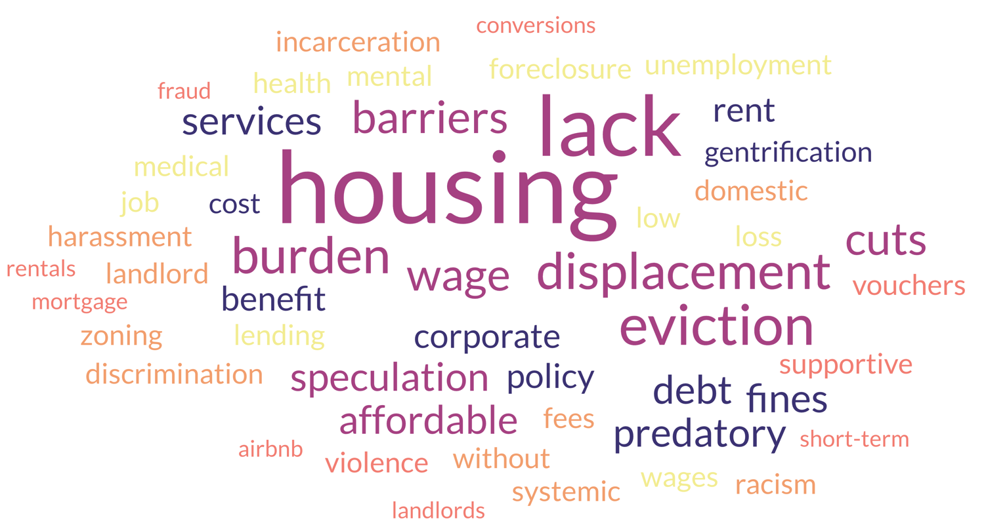
Why are people homeless?
(system models shift responsibility to external pressures)
Notes:
Ask the public, “Why are people homeless?” and you’ll hear words like lazy, addict, criminal. That’s the mental model at work—pushing responsibility onto individuals and leading to punishment: ordinances, arrests, bans. But when we study the system, we see something else: lack of housing, low wages, fragile safety nets. Where we assign responsibility determines the solutions we create. Blame the person, and you get punishment. Blame the system, and you get prevention, investment, and stability. Narrative isn’t side work—it’s strategy.
###END OF NOTE###

Slide 32
System Model (even bigger picture!)
Inflow
Outflow
Stock
Notes:
Now let’s connect it all: stock, inflow, and outflow. Inflow pushes people in; outflow—housing placements, vouchers, services—moves people out. When we see both, the picture makes sense. The Point-in-Time Count stops being mysterious. Housing First fits perfectly here—it speeds up outflow by stabilizing people and reduces churn from returns. That stability also frees capacity to address inflow. The question isn’t “How many people are homeless tonight?” but “What’s happening with inflow and outflow?” Once we understand that balance, we can manage homelessness as a system, not a snapshot.
###END OF NOTE###

Slide 33
Outflow Causes (homeless system response)
Permanent supportive housing placements
Rapid rehousing programs
Affordable housing development
Family reunification
Access to healthcare & addiction treatment
Employment programs leading to stable income
Rental assistance / vouchers
Diversion & prevention services
Community-based supports (faith groups, nonprofits)
Veterans' programs (HUD-VASH, SSVF)
Stock
Notes:
Think of the bathtub again: outflow is the drain we control. These are our exits—permanent supportive housing, rapid rehousing, affordable units, family reunification, healthcare access, employment, rental assistance, diversion, community supports, and veterans programs. When these are coordinated and funded, the water level drops. When fragmented or under-resourced, it rises. If we want to change the stock, we have to expand these exits deliberately and measure them in real time. Housing First keeps that drain open and flowing.
###END OF NOTE###

Slide 34
Systems Thinking Leads to System Modeling
Stock data shows who is homeless on a single night but not why or how numbers change
Inflow reveals pressures pushing people in
Outflow shows exits through rehousing or supports
Together, stock, inflow, and outflow reveal system dynamics and solutions
Notes:
Here’s where the lens becomes a blueprint. Stock data like the PIT Count gives us one night’s picture—who is homeless, not why. Add inflow and outflow, and the story deepens. Inflow shows pressures like rent and wages; outflow shows exits and cracks in the system. Together they reveal how homelessness behaves. Instead of “try harder,” systems thinking asks, “Where do we push?” Do we slow the faucet, widen the drain, or seal the leaks? Seeing those dynamics turns debate into design.
***END OF NOTE***

Slide 35
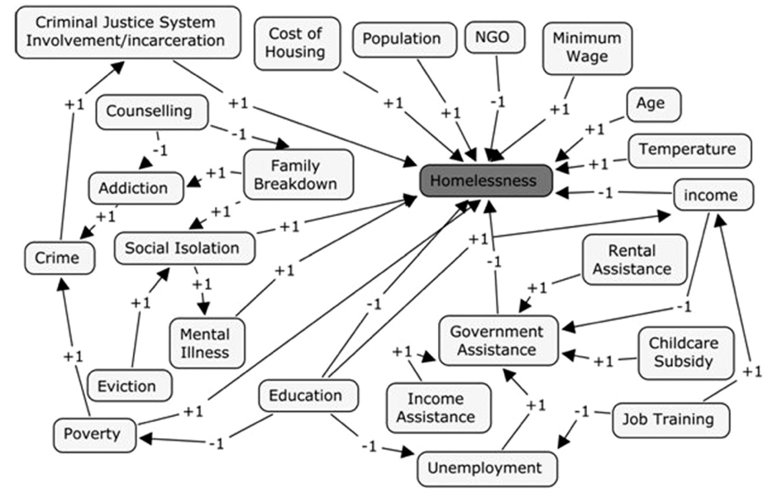
Homeless Causal Loop Diagram Example
Mago, Vijay & Morden, Hilary & Fritz, Charles & Wu, Tiankuang & Namazi, Sara & Geranmayeh, Parastoo & Chattopadhyay, Rakhi & Dabbaghian, Vahid. (2013). Analyzing the impact of social factors on homelessness: A Fuzzy Cognitive Map approach. BMC medical informatics and decision making. 13. 94. 10.1186/1472-6947-13-94.
Notes:
This diagram looks messy because real life is messy. It maps feedback loops—how housing, health, work, policing, and stigma amplify or ease homelessness. Some loops spiral upward, others down. Rising rents can cause evictions and worsen health, which makes employment harder. But supportive housing can reverse the loop—stability leads to income, income reduces returns. The key is we can’t hold all this in our heads. Modeling reveals where small, well-placed moves can create big, lasting change.
###END OF NOTE###

Slide 36
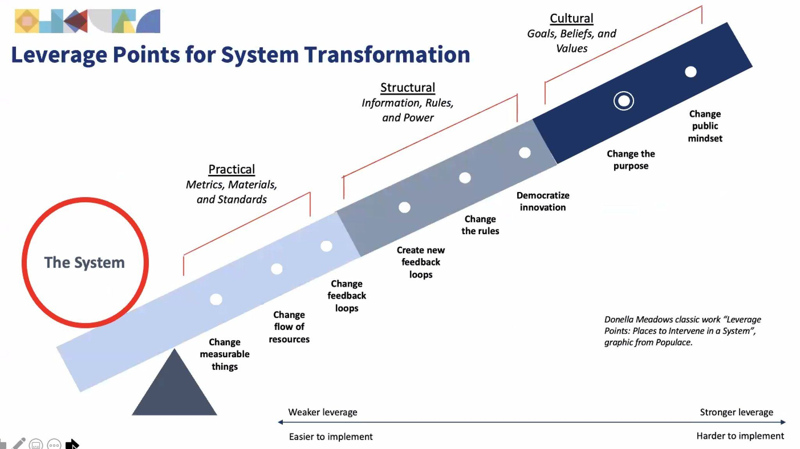
Leverage Matters!
Notes:
This visual shows where leverage lives. At the bottom are weak levers—metrics, materials, short-term tweaks. They’re visible but rarely transformative. Higher up are harder, more powerful levers: shifting resources, rewriting rules, creating new feedback loops. At the very top are cultural levers—changing beliefs, goals, and purpose. Once we shift how people think about homelessness, everything downstream changes. The real question isn’t “What can we fix?” It’s “Are we aiming high enough to change the system itself?”
###END OF NOTE###

Slide 37
Does it matter who’s responsible?
Blaming individuals is a losing game
Stock-only focus recycles leaders and people through the system
The real problem is upstream pressures that drive homelessness
Responsibility determines strategy
Notes:
When we blame individuals for homelessness, we set ourselves up to fail. It ignores the bigger forces at play. Focusing only on the stock—the count—just recycles people and leaders through the system. Communities look like they’re failing even as they house people daily. The true causes are upstream: rent, evictions, discharges, wages that don’t keep up. Where we assign responsibility determines what strategies we choose. Blame people, and we punish. Recognize pressures, and we design solutions that work.
***END OF NOTE***

Slide 38
Homeless Mental ($Profit$) Model
PROFIT!
Blame Homelessness on Individuals
Arrest Homeless
Criminalize Homelessness
Criminalize Homelessness
Increase Homelessness
Notes:
When we blame individuals—or even the CoC itself—we miss context. CoC leaders are often fighting huge inflow pressures driven by bad policy. Across the country, criminalization laws are rising: no-sleeping bans, arrests, curfews. These don’t reduce homelessness—they worsen it, pushing people deeper into instability and into profit-driven systems. Meanwhile, groups opposing Housing First exploit blame for political gain. This isn’t cynicism; it’s awareness. Even failed systems generate profit, and that makes change harder—but not impossible.
###END OF NOTE###

Slide 39
Homeless System (❤️Housing First❤️) Model
Long-Term Stability
Homeless
Respect, Dignity, & Trust
Immediate Housing Access
Connection & Belonging
Choice-Based Support Services
Notes:
Housing First is the counter-model. It’s not “housing only”; it’s housing first, then support. That order matters. Without housing, health, work, and recovery wobble. With it, they stabilize and grow. Housing First widens outflow, reduces returns, and lowers costs. If homelessness is a bathtub filling faster than it drains, Housing First is the tool that clears the drain and seals the leaks. Punishment increases churn; Housing First creates stability. One keeps the cycle alive; the other breaks it.
###END OF NOTE###

Slide 40

Housing First reduces outflow friction and recidivism
When scaled, it frees system capacity and stabilizes exits
Works best when paired with prevention and diversion
Notes:
Housing First isn’t just a program—it stabilizes the entire system. Removing preconditions smooths outflow and reduces people cycling back into homelessness. Scaled up, it frees capacity and lowers pressure. Paired with prevention and diversion, it balances both sides of the equation: fewer people pushed in, more people exiting successfully. It’s not the end of a process but the anchor of system design—turning compassion into structure and stability into measurable results.
###END OF NOTE###

Slide 41

Blame Shapes Outcomes
Blame on individuals → punishment & criminalization
Blame on the system → solutions that expand outflow
Housing First = stability, fewer returns, lower costs
Where we place blame determines whether we repeat the cycle or break it
Notes:
Framing changes everything. When we blame individuals, we get punishment—ordinances, arrests, curfews, revolving shelters. Those manage people, not causes. When we see homelessness as a system problem, responsibility shifts. The question becomes, “What’s wrong with the system?” That leads to solutions like Housing First, prevention, and fair-wage policy. Housing First meets compassion with design—it stabilizes people and repairs the system itself. Where we place blame decides whether the cycle repeats or finally ends.
-TIME DEPENDENT-
-Before we move on, take a minute to talk with someone near you. In your community’s conversations about homelessness — in the news, on social media, or in meetings — where does the blame usually land? On individuals? On systems? Somewhere else?
-*2-minutes*
-That conversation — where we place responsibility — literally shapes what we build. When we blame people, we design punishment. When we see systems, we design stability. And that shift is where real change starts.
***END OF NOTE***

Slide 42

From Compassion to Design
Turning principles into practice
Housing First gave us the what — stable housing
Systems thinking gives us the how — stability through design
Data gives us the tools — clarity, feedback, and leverage
Notes:
Housing First taught us what works—stable housing with support. Systems thinking shows us how to make that stability last. It’s not just about helping individuals; it’s about designing structures that make stability predictable. Data turns that design into feedback—showing where things move, stall, or break. When we combine compassion, design, and data, we move from philosophy to precision. This is how empathy becomes architecture—building systems that make good work the default rather than the exception.
###END OF NOTE###

Slide 43
Where Do We Go From Here?
Turning understanding into impact
Notes:
Everything so far has been about seeing differently—the loops and flows that shape homelessness. But seeing isn’t enough. Change happens when insight becomes structure. This section is about turning systems thinking into systems doing—designing systems that put what we’ve learned into action. We’ll start by looking at how HUD measures performance nationally, then explore tools communities can use to build stronger, smarter systems. Think of this as the shift from ideas to architecture—where empathy becomes strategy.
###END OF NOTE###

Slide 44
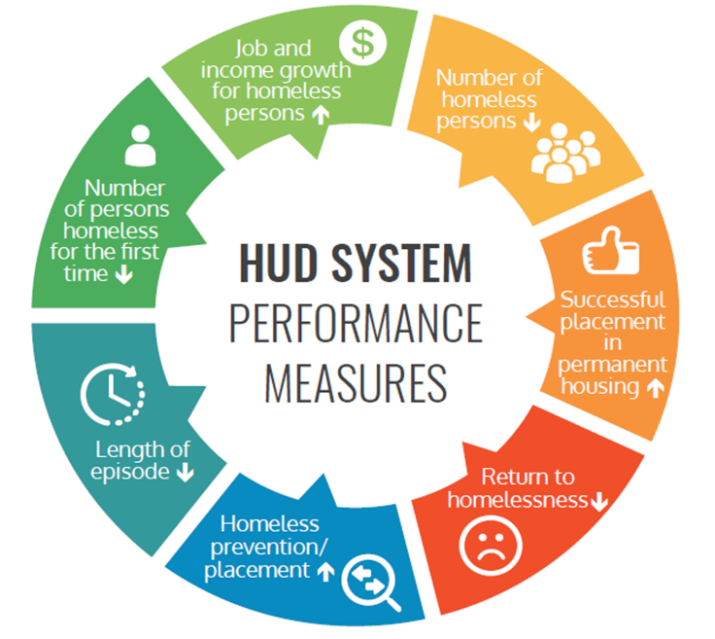
HUD System Performance Measures
Measuring system performance
Six measures: time homeless, returns, first-time homelessness, exits to permanent housing, income growth, total population trends
Designed to measure outcomes at the system level
Creates shared language but limited insight into causes
Notes:
HUD’s System Performance Measures were the first real attempt to track homelessness as a system rather than separate programs. They measure six areas: time homeless, returns, first-time homelessness, exits to housing, income growth, and population trends. These metrics create a shared language and accountability. But they’re snapshots—they show what happened, not why. They’re useful for direction, but limited for diagnosis. Without context or feedback loops, we manage numbers, not systems. We need more than measurement; we need understanding.
###END OF NOTE###

Slide 45
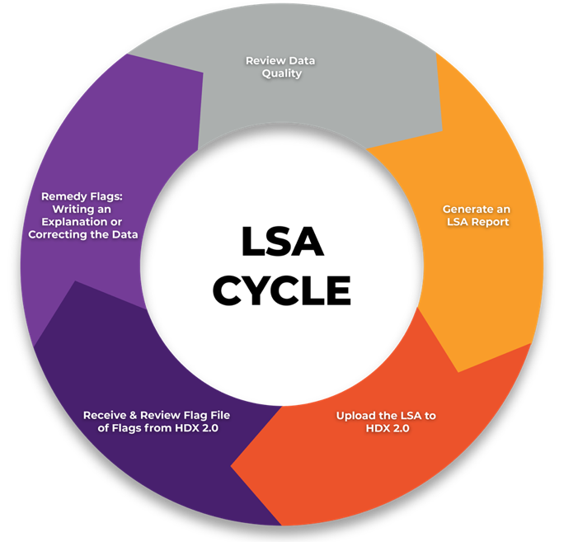
Longitudinal Systems Analysis (LSA)
Tracking entries, exits, and returns (LSA)
Multi-year person-level dataset tracking transitions
Shows duration, exits, and returns over time
Reveals recycling and long-term trajectories across project types
Notes:
The Longitudinal Systems Analysis, or LSA, connects multiple years of person-level data to show how people move through homelessness: how long they stay, where they go, and whether they return. It replaces single-night snapshots with a moving picture. We can see recycling, flow, and rhythm—how the system breathes. Its limit is scope: it tracks what happens inside the homeless response system, not the external pressures feeding it. So it’s a powerful X-ray of system health—but not the full body scan.
###END OF NOTE###

Slide 46
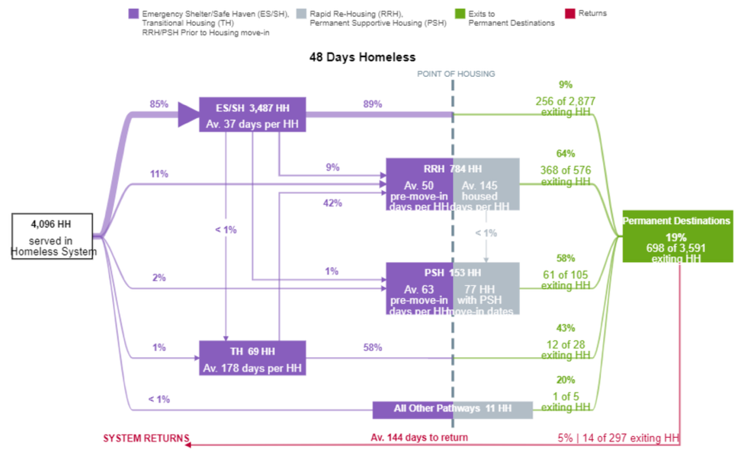
Stella P & Stella M
Modeling outcomes and scenarios
Stella P visualizes system performance outcomes
Stella M models supply, demand, and flow to test scenarios
Together they move from description to simulation but simplify external feedback
Notes:
Stella takes it further. Stella P—Performance—shows how inflow, outflow, and inventory interact over time. Stella M—Modeling—lets communities test “what if” scenarios: What if we expand prevention or rebalance rapid rehousing and supportive housing? It moves us from describing the past to rehearsing the future. The models aren’t perfect—they simplify reality—but they let us simulate choices before we spend a dollar. Used well, Stella is a flight simulator for strategy—helping leaders see consequences, debate trade-offs, and design change collaboratively.
###END OF NOTE###

Slide 47
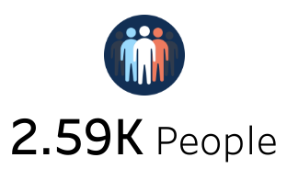
Static Snapshot vs. Dynamic Systems
Why one number hides more than it shows
A KPI like 2.59K people represents stock, not flow
It shows who is homeless, not why or how they move
Snapshots feel certain but miss system behavior
Notes:
When evaluating tools used to analyze or diagnose a system, it's important to know the best application for those tools and whether we need to expand on what they are showing us.
For example, A single KPI—like how many people are homeless today—feels concrete, but it hides movement. It doesn’t show how many entered or exited, how many will return, or how trends are changing. It’s a still photo of a moving river. The system might be improving or worsening beneath the surface, and we’d never know. When we rely only on static numbers, we manage by hindsight. The key is turning snapshots into motion pictures—so we can anticipate, not just react.
###END OF NOTE###

Slide 48
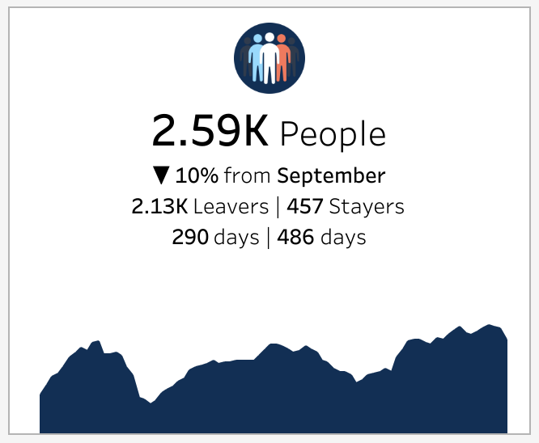
From Pictures to Movies
Adding time reveals system breathing
KPI with over-time graph connects stock to flow
When inflow exceeds outflow, stock rises
When outflow exceeds inflow, stock falls
Notes:
Now, let’s unfreeze the frame. When we add inflow and outflow data, the system starts to breathe. The line rises and falls—people entering and leaving. When inflow exceeds outflow, homelessness grows. When outflow outpaces inflow, it shrinks. That rhythm reveals balance or imbalance. Once we can see that rhythm, we can act intentionally to change it. Data stops being a report card and becomes an instrument panel—something we steer with, not just measure.
###END OF NOTE###

Slide 49
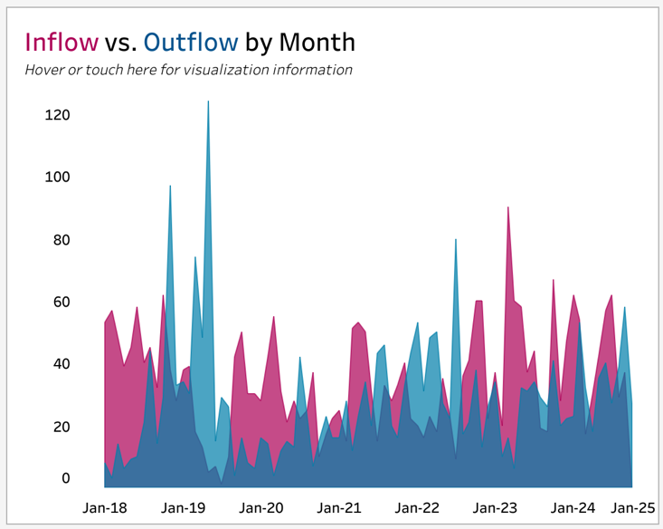
Inflow vs Outflow
Reading the heartbeat of a system
Area chart comparing monthly inflow and outflow
Inflow represents new entries into homelessness
Outflow represents exits and returns to housing
Balance determines system direction over time
Notes:
Here, flow becomes measurable. Each month, we track how many people enter versus how many leave. When inflow stays higher, the total rises no matter how hard we work. When outflow overtakes inflow, the stock drops. The balance point—the intersection of the two—is the system’s heartbeat. Every policy choice—prevention, housing expansion, eviction reform—shows up here. The goal isn’t perfection; it’s rhythm: steady or reduced inflow, strong outflow, and reduction over time.
###END OF NOTE###

Slide 50
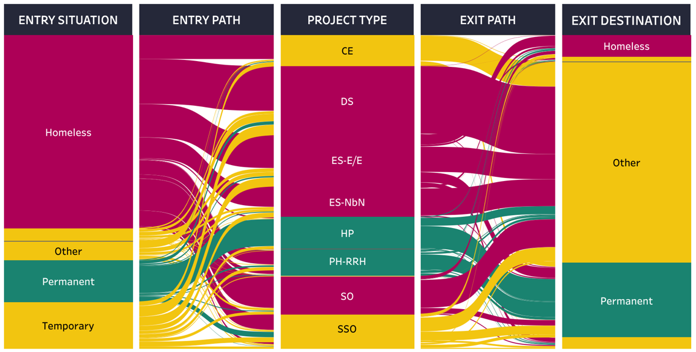
When “Other” Becomes a System Outcome
When data looks better than reality
Notes:
This is an example of a homeless system flow chart. It shows the situation that people were in when they entered the homeless system, what project type they were enrolled in, and the exit destination when they left. The overall idea is to have lots of red on the left and very little red on the right, and conversely, a little green on the left and lots of green on the right!
When we zoom in on this example community, something stands out. Most people enter from homelessness, but many are exited to “Other.” That’s not a real destination—it’s missing data. Sometimes it means no exit interview, sometimes staff didn’t know, sometimes it was entered optimistically. But when “Other” grows this large, the numbers stop telling the truth. It hides real outcomes and inflates success. Good data isn’t about blame—it’s about learning what’s real so we can fix what’s not.
###END OF NOTE###

Slide 51
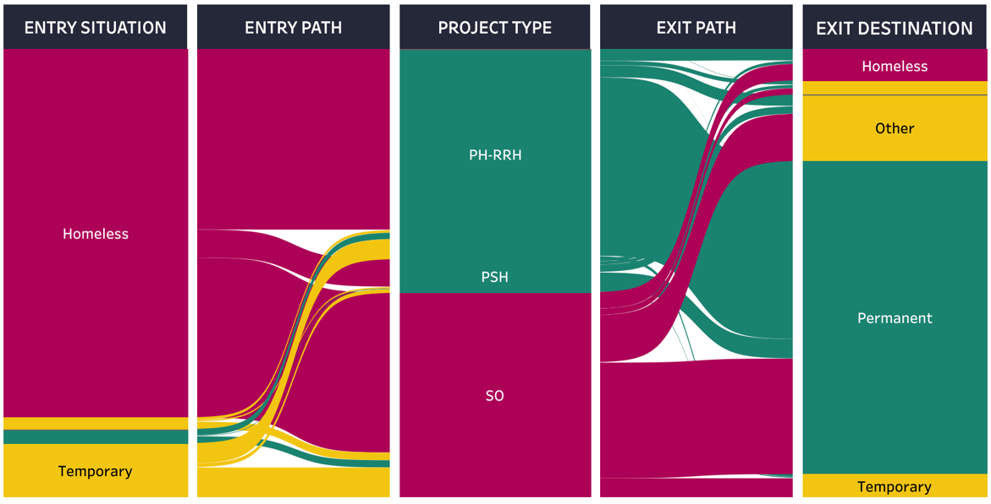
Flow Success: PCHO
A system that moves people forward
Notes:
This is what success looks like when systems align. This example—Person Centered Housing Options in Rochester, New York—shows people entering directly from homelessness on the left, and green expanding on the right: exits to permanent housing. The red nearly disappears. That means their system is doing exactly what it’s designed to do—moving people from crisis to stability. It’s proof that Housing First works when implemented at scale and supported by alignment. Data isn’t just measurement—it’s storytelling for progress.
###END OF NOTE###

Slide 52
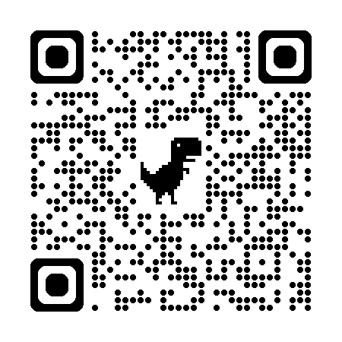
DEMONSTRATION (Time Permitting)
Experience the demo at GaitherDyn.com/demo
Notes:
###END OF NOTE###

Slide 53
Beyond System Flow: What Comes Next
Future directions in systems thinking for homelessness
Causal loop modeling — mapping feedback beyond inflow and outflow
System archetypes — identifying recurring patterns like “Fixes that Fail”
Leverage point analysis — finding small changes with big, lasting impact
Scenario simulation — testing long-term policy
Scenario simulation — testing long-term policy choices before acting
Boundary expansion — connecting homelessness data to housing, health, and justice systems
Collective sense-making — using systems maps to build shared understanding across agencies
Notes:
We’ve explored systems thinking as a way to understand and visualize homelessness — but this is really just the beginning. Beyond inflow and outflow, the next step is modeling the feedback loops themselves. Tools like causal loop diagrams help map how policies, funding cycles, and public perception reinforce each other — often unintentionally. We can also look for system archetypes, recurring patterns like “Fixes that Fail,” where short-term solutions make long-term problems worse. The real power comes from leverage point analysis — identifying small, targeted changes that shift the whole system. Finally, we can expand boundaries by integrating housing, health, and justice data, because homelessness doesn’t live in isolation. These approaches move us from reacting to immediate symptoms to true system design — where communities learn, adapt, and evolve together.
###END OF NOTE###

Slide 54
Explore Systems Thinking Further
Tools, books, and courses to go deeper
MIT OpenCourseWare – System Dynamics & Organizational Learning
Jay W. Forrester: Urban Dynamics and Principles of Systems
Donella Meadows: Thinking in Systems: A Primer
Peter Senge: The Fifth Discipline
John Sterman: Business Dynamics (MIT Sloan)
The Systems Thinker (free online journal)
System Dynamics Society – community and case studies
Kumu.io – build interactive causal and feedback maps
Stella Architect – advanced system modeling software
Iceberg Model & Causal Loop Diagram templates (Systems Innovation)
Notes:
For anyone who wants to go further, there’s a whole world of systems thinking resources. MIT’s OpenCourseWare offers free classes in System Dynamics taught by John Sterman. Donella Meadows’ Thinking in Systems and Peter Senge’s The Fifth Discipline are classics. Tools like Kumu and Stella Architect help map feedback loops and simulate change. Journals like The Systems Thinker and the System Dynamics Society share real-world applications in housing and public policy. These aren’t abstract ideas—they’re practical tools communities can use right now to redesign local systems and test real solutions.
###END OF NOTE###
https://ocw.mit.edu/courses/sloan-school-of-management/15-871-introduction-to-system-dynamics-fall-2013/
https://mitsloan.mit.edu/faculty/directory/john-d-sterman
https://www.chelseagreen.com/product/thinking-in-systems/
https://www.penguinrandomhouse.com/books/286706/the-fifth-discipline-by-peter-m-senge/
https://kumu.io/
https://www.iseesystems.com/store/products/stella-architect.aspx
https://thesystemsthinker.com/
https://systemdynamics.org/

Slide 55
Turning Insight Into Action
Applying systems thinking to real-world change
Identify inflow pressures — link data to housing, wages, and local policy
Address outflow capacity — expand exits that reduce system pressure
Break systems into parts — find multiple levers, not one silver bullet
Visualize connections — show relationships between data, policy, and people
Close feedback loops — fix “Other” exits and follow returns
Design for alignment — ensure programs, data, and goals move together
Notes:
Everything we’ve discussed leads here—action. Start by tracing inflow back to its roots: rent, wages, healthcare access, discharge policies. Meet with local policymakers. Help them understand Housing First and how system design—not individual failure—drives outcomes. Strengthen outflow intentionally: expand exits, stabilize supports, fix “Other” exits, track returns. But don’t stop there—shape public sentiment. Write opinion pieces, speak at town halls, share success stories. Influence the narrative so compassion and logic outlast politics. Investigate levers beyond your system—zoning, healthcare, justice—and connect them back to housing. Systems thinking maps the problem; advocacy and collaboration drive change. Together, they transform insight into impact.
###END OF NOTE###

Slide 56
How’s It Going? Questions/Comments
Engage!
Notes:
We’ve come full circle — from Bob and his pillar, to the bathtub, to snapshots versus movies. Each one revealed something deeper about how we think — and how the systems we build reflect that thinking back to us.
When we think in systems, every action creates a feedback loop. The question isn’t whether that loop exists — it’s whether it amplifies problems or builds stability. Our challenge isn’t to control every variable; it’s to align them. To connect compassion with data, empathy with structure, and evidence with design. When those move together, systems stop reacting and start learning. That’s how communities evolve — from managing homelessness to redesigning the conditions that cause it.
For too long, we’ve treated homelessness like a series of still photos — frozen moments that capture struggle but not motion. And in that frame, blame creeps in. We blame people, programs, or moments because that’s what we can see. But systems thinking invites us to press play — to watch the whole movie. Because once we do, we see the true pattern: inflow, outflow, pressure, and possibility.
Housing First works because it shifts that lens. It moves blame off individuals and onto the pressures shaping their lives — rent, wages, policy, opportunity. It stops asking, “What’s wrong with this person?” and starts asking, “What’s wrong with the system?” It treats stability as design, not luck — turning compassion into structure and feedback into change.
So think about Bob, the bathtub, and the movie. Think about how perspective transforms everything — how the story changes once we see the whole system at work. Where we place blame determines what kind of system we build. And when we finally see the full, moving picture, that’s when we can build one that truly works.
And with that — I’d love to hear your thoughts and questions.
###END OF NOTE###

Slide 57
Thanks!
Still have questions or comments?
Gaither.Stephens@GaitherDyn.com
GaitherDyn.com
CoCAlliance.org
Notes:
Thank you all so much for being here — and for the work you do every day to make your communities stronger.
I’ll be around for the rest of the conference if you’d like to keep the conversation going — I always love hearing how other communities and organizations are approaching these challenges.
And if you’d like to connect after the conference, you can always email me at Gaither.Stephens@GaitherDyn.com or reach me online at GaitherDyn.com — there’s an easy way there to schedule a virtual meeting on the site.
Thanks again for your time, your ideas, and your heart for this work.
###END OF NOTE###

