Slide 1
Race, Rent, and Power
by Gaither Stephens
Notes:
Good afternoon, everyone. I’m really glad you’re here.
Today, I want to explore three forces that shape almost every housing outcome in America — race, rent, and power. My goal isn’t to drown you in data or tell you something brand new. It’s to take what you already know, connect the dots, and make it simple enough to investigate, act on, and share.
By the end, I’ll show you a live racial equity dashboard that makes these patterns visible — because once you can see inequity clearly, you can’t unsee it. And that’s where change starts.
###END OF NOTE###

Slide 2
Agenda
01
02
03
04
Who Is Gaither Stephens?
Racial Equity – The Foundation
Data as Truth-Teller
Seeing the Story: From Numbers to Meaning
05
Live Demo: Equity in Action
06
Questions/Thank You!
Notes:
Here’s where we’re headed.
We’ll start with a little background about who I am and how I got here, then move into what racial equity really means — and why rent and power are so tightly linked.
After that, we’ll look at how data helps us separate what’s true from what’s assumed, and how visualization transforms that truth into something anyone can understand.
Then we’ll bring it all together in a demo of the Community Equity Dashboard — and wrap up with your questions and thoughts.
###END OF NOTE###

Slide 3
Rethinking Equity: A Shared Starting Point
Why the housing conversation must evolve
Equity ≠ equality — it’s about fair outcomes
Housing inequity is historic and measurable
Data helps us see what we’ve missed
Notes:
Before we can talk about housing or data, we need a shared understanding of equity.
Equality says, “Give everyone the same rules.” Equity says, “Make sure the rules work the same for everyone.” That’s a big difference.
Housing inequity isn’t random — it’s the legacy of policies that privileged stability for some and made it optional for others.
But inequity leaves a trail. It’s measurable. And that means we can visualize it, test it, and — if we’re willing to face it honestly — fix it.
***END OF NOTE***

Slide 4

01
Who is Gaither Stephens?
CEO | National Speaker | Data Scientist | Board Member
Notes:
I didn’t start my career in housing or even in data — I started in radio. For nearly 20 years, I managed seven stations across three states, with about 50 employees and a lot of chaos.
It was a crash course in systems, leadership, and problem solving. Later, I went back to school for information systems, business, and database management. That combination of people, systems, and data eventually became my language for understanding how organizations — and entire communities — work.
###END OF NOTE###

Slide 5

Gaither Stephens
The Early Years
Education
AS – Information Systems, Purdue University
BS – Business Administration, Indiana Wesleyan
MS – Database Management & Business Intelligence, Boston University
Early Career
Nearly 20 years managing 7 radio stations across 3 states
Managed 50+ staff across multiple offices and studios
Notes:
Radio taught me more about systems than I ever expected. Every audience rating, every playlist, every marketing budget — it was all data feedback.
When I started studying business intelligence, I realized it was the same logic on a bigger scale. You can’t fix what you don’t measure, and you can’t measure what you don’t define.
That idea — that clarity drives improvement — is what I carried with me when I moved into the housing and homelessness field.
###END OF NOTE###

Slide 6

Gaither Stephens
Work in Homelessness
Charlotte County Homeless Coalition
  Data Analyst Board Member
  Gulf Coast Partnership Chief Technology Officer
Gaither Dynamic
  CEO – built dashboards for 60+ communities
CoC Alliance
  Founder/President
NHSDC, FCEH, FHC, PCHO
  National Presenter
Notes:
When I made that shift, I started as a data analyst and later became a CTO for a Continuum of Care.
Eventually, I launched Gaither Dynamic, building dashboards for more than 60 communities across the country.
But this work isn’t abstract for me — it’s personal. That’s my son in the photo. He’s experiencing homelessness right now in Los Angeles. So when I talk about data, I’m not talking about numbers on a screen. I’m talking about people like him — people who deserve systems that actually work.
***END OF NOTE***

Slide 7

Charlotte County Homeless Coalition Staff Photo 2016
ME
Notes:
This photo was from one of my first teams at the Charlotte County Homeless Coalition.
When I look at it, I’m reminded that behind every number we’ll talk about today are faces like these — colleagues, neighbors, families trying to help families.
These aren’t abstract metrics — they’re lives.
That’s why accuracy and integrity in data matter so much. Because when we get the data wrong, it’s not just a bad report. Real people pay the price.
###END OF NOTE###

Slide 8

Charlotte County Homeless Coalition Board Photo 2024
ME
Notes:
This is from a few years later, serving on the board of the very same organization I had started out at as a data analyst. And it taught me something simple but powerful — systems don’t change in silos.
Data scientists can’t do it alone. Neither can policymakers or frontline staff. Real progress happens when everyone starts speaking the same language and moving in the same direction.
That’s what equity really is — alignment. It’s everyone rowing the same boat instead of arguing about who gets the oars.
###END OF NOTE###

Slide 9

Why This Work Matters
Notes:
For me, this slide sums it all up. Data, systems, and dignity are inseparable.
Every number you’ll see today represents a person — and every dataset is a story about whether that person found stability or slipped through the cracks.
When we treat data as compliance, we reduce people to counts. But when we treat data as a mirror — a way to reflect what’s really happening — we build trust, we learn faster, and we actually help people.
That’s why this work matters.
###END OF NOTE###

Slide 10
02
Racial Equity – The Foundation
Defining the forces shaping housing outcomes
Notes:
Before we get too deep, I want to set expectations. I’m not here to tell you things you don’t already know — I just want to make what you already do know compact enough to investigate, act on, and share.
When I say “Race, Rent, and Power,” I’m talking about three threads woven through every housing outcome. Race determines who’s invited or excluded. Rent is the toll we pay to stay included. Power decides who sets that toll — and who collects it.
They don’t act separately; they write the script together. And that script decides who thrives, who struggles, and who gets left out.
###END OF NOTE###

Slide 11
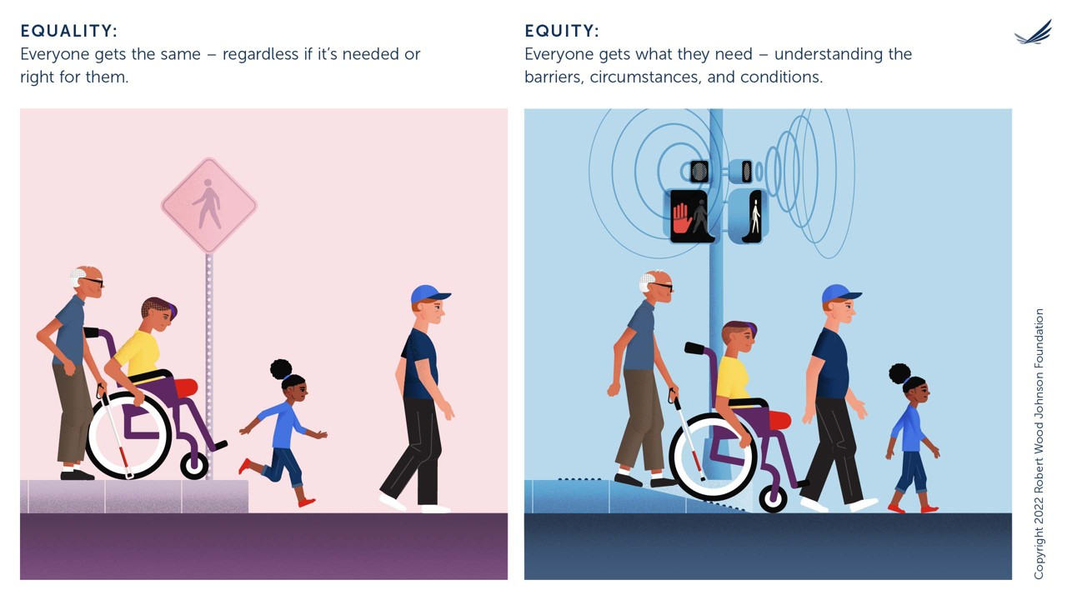
Notes:
Before we dive into history, let’s start with something visual.
Equality gives everyone the same thing. Equity gives people what they actually need.
In this image, everyone gets a sidewalk — but only one person can really move forward. The difference isn’t about effort; it’s about design.
Housing programs often make this same mistake. We use the same process for everyone, then call the results “fair.” But fairness isn’t about sameness; it’s about removing the barriers that were built unevenly to begin with.
###END OF NOTE###

Slide 12
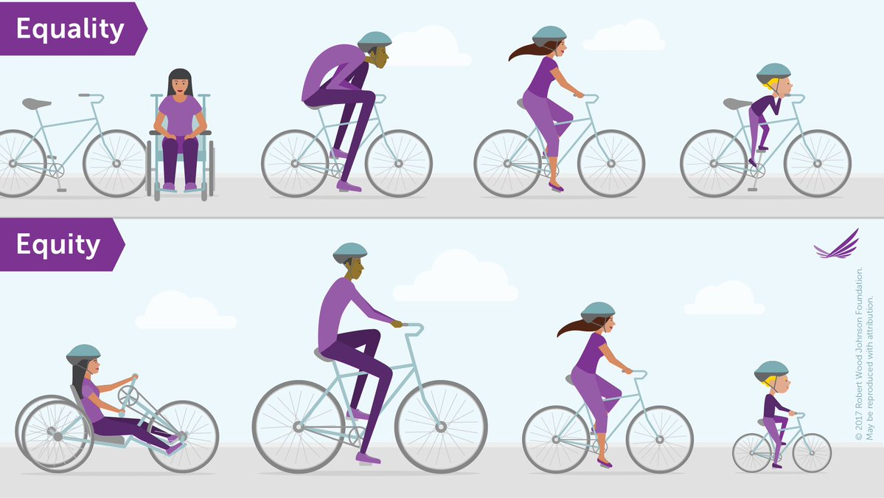
Notes:
Here’s that same lesson in another form. Everyone gets a bike — but not everyone can ride it.
This is what happens when policy is built for the “average” person. The average person doesn’t exist.
Equity is about fit — designing systems that meet people where they actually are so everyone has a real chance to move forward. When we get the fit wrong, we don’t close gaps — we reinforce them.
###END OF NOTE###

Slide 13
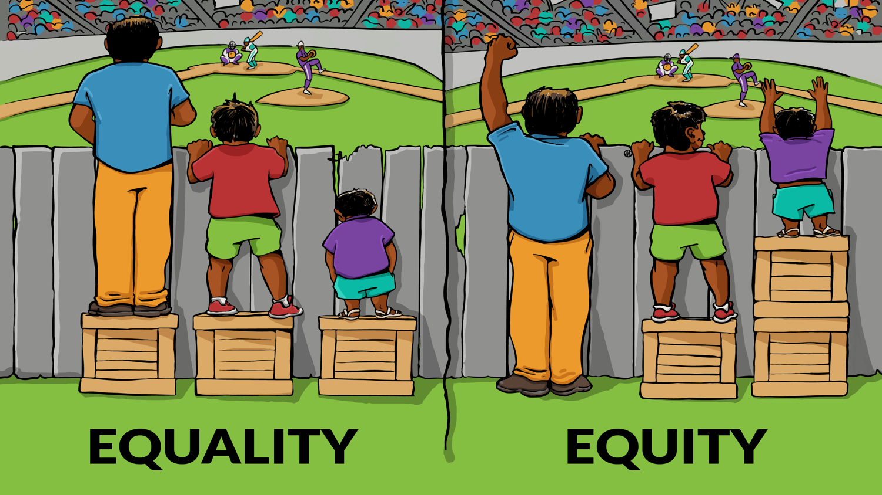
Notes:
This image takes it a step further. Equality gives everyone the same box to stand on. Equity gives people what they actually need to see the game. In housing, that might look like targeted rent relief, fair-chance screening, or voucher protections — policies that lift those blocked by taller fences. It’s not favoritism; it’s fixing sightlines. When we pretend everyone’s view was equal to begin with, some people are left staring at the fence forever.
###END OF NOTE###
https://interactioninstitute.org/illustrating-equality-vs-equity/

Slide 14
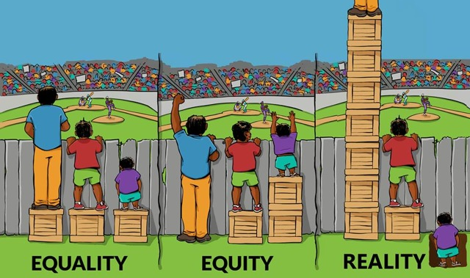
Notes:
This version adds the truth panel: reality. Even when we build boxes or programs, some still can’t reach the view while others tower above it. Reality is where we live — a mix of privilege, pressure, and policy. It reminds us that good intentions don’t cancel old math. We can’t close racial rent gaps with programs that only paper over structural costs. Reality is the part of the fence we still pretend isn’t there.
###END OF NOTE###

Slide 15
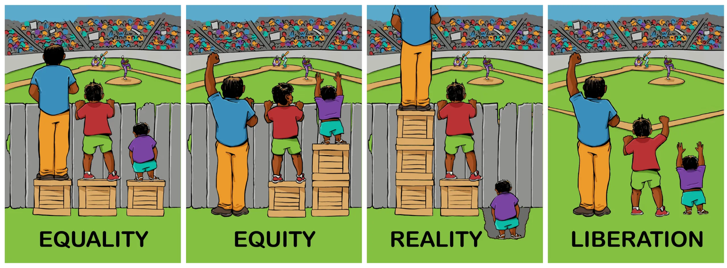
Notes:
This final frame shows what we’re all working toward: liberation. In the first three scenes, we’re still managing imbalance — building boxes, adjusting height, trying to make the game visible. Liberation is when the entire fence is redesigned or removed because it’s no longer needed. It’s when fairness isn’t an after-thought policy but the default condition of the system. That’s the dream for housing: a market and a culture where affordability, access, and respect don’t depend on constant correction. Equity is the bridge we build; liberation is the point when everyone can cross without it.
###END OF NOTE###

Slide 16
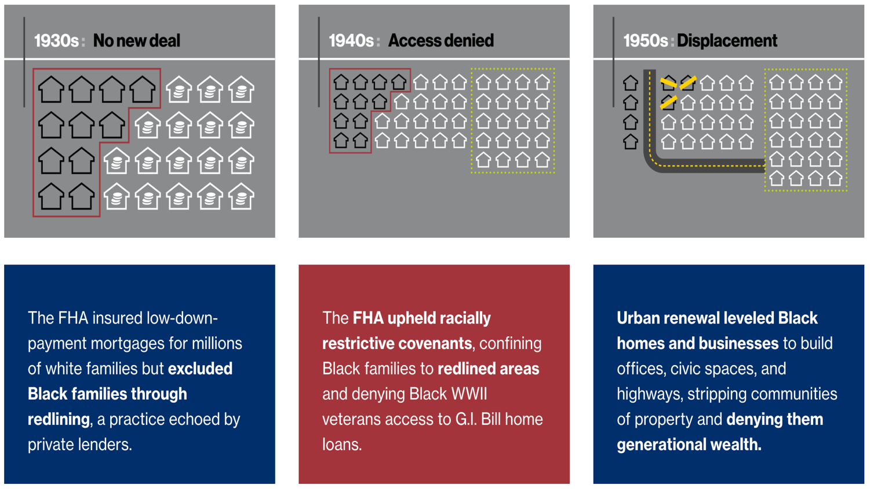
Notes:
Now that we’ve talked about equity and what fairness should look like, let’s talk about how we got so far from it in housing. In the 1930s, the Federal Housing Authority insured low-down-payment mortgages for millions of white families—but excluded Black families through redlining. Redlining is the act of refusing (a loan or insurance) to someone because they live in an area deemed to be a poor financial risk. In the 1940s, the GI Bill promised opportunity but upheld racially restrictive covenants, denying Black veterans access to those loans. By the 1950s, “urban renewal” cleared entire Black neighborhoods for highways and civic projects. Each policy reinforced the next: exclusion → confinement → displacement. The result was not just segregation—it was stolen opportunity, and the start of a rent-based system where ownership for some meant dependency for others.
###END OF NOTE###
https://www.habitat.org/historic-housing-discrimination-us

Slide 17
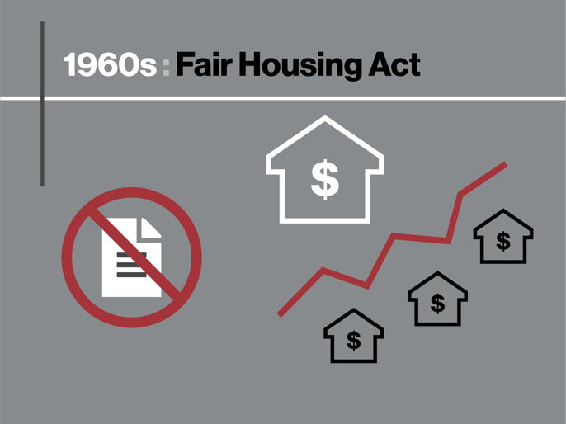
The 1960s – Fair Housing in Name Only
Progress on paper, persistence in practice
The Fair Housing Act of 1968 prohibited racially restrictive deeds, but economically exclusionary zoning practices multiplied, locking in racial segregation.
Notes:
In 1968, the Fair Housing Act banned racially restrictive deeds—a huge step—but it didn’t stop exclusion. Cities simply swapped racial language for economic zoning. Multifamily units were zoned out, “lot-size minimums” priced out lower-income families, and mortgage access remained tilted. In effect, the law stopped saying “you can’t live here,” but it didn’t change the systems making that true. That’s why racial segregation remained baked into our housing map long after the ink on that law dried.
###END OF NOTE###

Slide 18
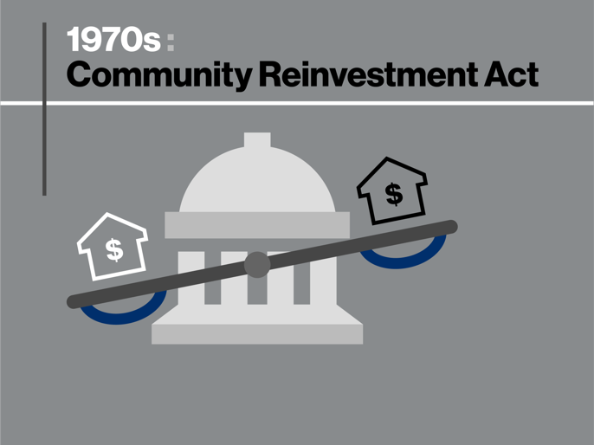
The 1970s – Credit and Reinvestment
Fixing the rules without fixing the referees
The Community Reinvestment Act in 1977 was meant to hold banks more accountable for meeting the credit and banking needs of their entire communities, but Black citizens continued to be targeted with racist practices, including predatory mortgages and refinance programs.
Notes:
By the ’70s, policymakers tried to repair decades of redlining with the Community Reinvestment Act. It asked banks to lend fairly in all neighborhoods. But here’s the problem: the same institutions that created red lines were now grading their own homework. Black borrowers were still targeted with predatory loans, inflated interest rates, and refinance scams. The law’s spirit was equity, but the practice remained extraction. If redlining said, “you can’t have credit,” predatory lending said, “you can — but it’ll cost you more.”
###END OF NOTE###

Slide 19
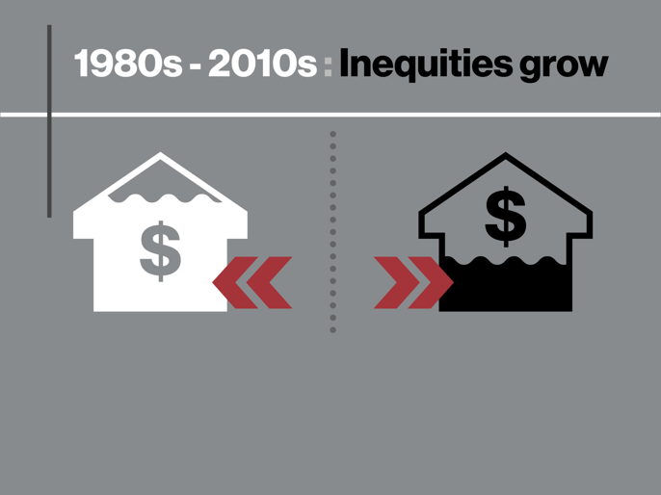
The 1980s-2010s – Inequities Grow
From ownership loss to rent dependence
Racial parity in housing remained elusive, and inequalities worsened. In 2008, the Great Recession disproportionately affected Black homeowners that had been steered into predatory loans and were left more vulnerable to losing their homes, contributing to the homeownership gap progressing little since the Fair Housing Act was passed in 1968.
Notes:
From the 1980s through the Great Recession, racial parity in housing remained elusive. Subprime lenders preyed on Black and Latino homeowners, steering them into high-risk loans even when they qualified for better ones. When the crash hit, those families lost homes — and the wealth that should have built stability for the next generation. Investors then bought those foreclosures and turned them into rentals, raising prices for everyone. That’s how we went from an ownership gap to a rent trap. When we talk about affordability today, this is what we’re really measuring — the cost of yesterday’s policy still collecting interest.
###END OF NOTE###

Slide 20
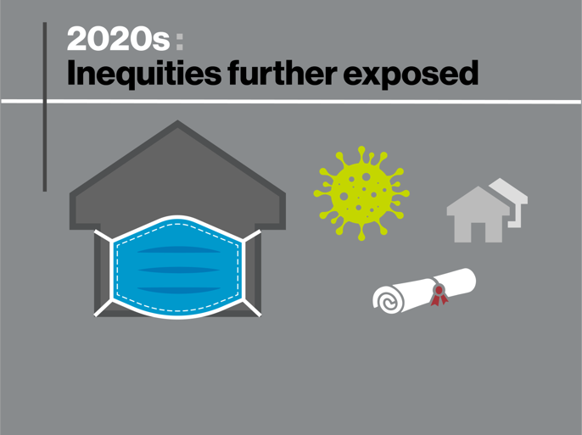
The 2020s – Inequities Further Exposed
A crisis laid bare
The pandemic didn’t just reveal inequities — it accelerated a reckoning. Data transparency, eviction moratoriums, rent relief programs, and racial equity pledges reshaped how housing systems measured fairness. For the first time, “equity” became a performance metric, not a side project. The 2020s mark a shift from describing disparity to designing accountability.
Notes:
COVID didn’t create inequality — it made it impossible to ignore. What changed in the 2020s wasn’t just exposure but accountability. For the first time, we saw eviction moratoriums, rent-relief dashboards, and equity goals baked into funding decisions. Data became part of the response, not just the diagnosis. This decade marks the moment when equity stopped being an aspiration and started being measured.
###END OF NOTE###

Slide 21
Rent Pressure and Power Today
Why “affordable” isn’t equal for everyone
Black renters: 58% pay > 30% of income on rent
Hispanic/Latino renters: 54%
White renters: 42%
Notes:
So here’s what that history leaves us with today. More than half of Black renters—and over half of Latino renters—spend at least 30 percent of their income on rent. For white renters, it’s about 42 percent. That difference might sound small, but it’s what separates stability from stress. It means fewer savings, fewer choices, and less protection when something goes wrong. Rent isn’t just a payment; it’s a pressure valve that determines who stays secure and who stays scared. When rent keeps rising faster than wages, it’s not just expensive—it’s exclusion reinvented.
###END OF NOTE###

Slide 22
From Rent to Homelessness
The pipeline we rarely measure
Rent Burden → Eviction → Instability → Homelessness
Notes:
When we trace this line out, we see the real story. The same neighborhoods redlined 80 years ago are still the ones with the highest eviction rates and the greatest homelessness today. That’s not coincidence—it’s continuity. Rent pressure pushes families to the edge, eviction delivers the shove, and the system measures it only when it becomes homelessness. But if we wait until someone loses everything to intervene, we’ve already failed. Preventing homelessness starts with stabilizing rent and dismantling the barriers that make stability uneven in the first place.
###END OF NOTE###

Slide 23
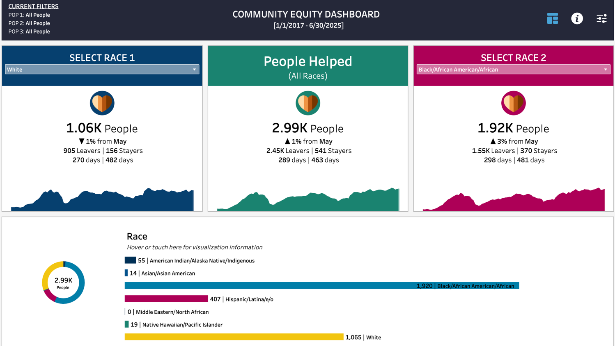
PCHO Racial Equity Dashboard
GaitherDyn.com/equity
PREVIEW
PREVIEW
Notes:
Everything we’ve talked about so far — the history, the policy shifts, the inequities that ripple forward — they all leave a fingerprint in the data. The dashboard I’ll show you later makes those fingerprints visible. It breaks down homelessness, housing rates, chronic homelessness, children in crisis, and returns to homelessness — all side-by-side by race. You can explore who’s entering the system, who’s being housed, and who’s coming back. It’s not about numbers for numbers’ sake; it’s about accountability. Because when we can see disparity in real time, we can stop debating if it exists and start asking the only question that matters — what are we going to do about it?
###END OF NOTE###

Slide 24
03
Data as Truth-Teller
Data elements are the building blocks to knowledge and improvement
Notes:
Data is how we hold systems accountable — not people, systems. It takes lived experience and turns it into something measurable. When we talk about race and housing, data becomes our mirror. It shows how bias behaves when it’s scaled up — who’s getting housed faster, who’s waiting longer, who’s returning. Done right, data turns compassion into evidence and keeps equity work from running on opinion instead of proof.
###END OF NOTE###

Slide 25


“When we fail to count people accurately, we fail to serve them effectively.”
-Dr. Martin Luther King, Jr.
Notes:
"When we fail to count people accurately, we fail to serve them effectively."
Every system starts as a story — who deserves help, who’s “earned” stability, who hasn’t. When those stories aren’t measured, they harden into policy. That’s how inequity becomes infrastructure — invisible but permanent. The beauty of data is that it helps us unearth those buried stories and see the consequences clearly. When we count everyone, we serve everyone.
###END OF NOTE###

Slide 26
Data as Truth-Teller
Turning stories into signals
Data translates lived experience into measurable reality.
It connects compassion to accountability.
It’s how we move from “I think” to “we know.”
Notes:
Data tests the stories we tell ourselves. It connects compassion to accountability and helps us move from “I think” to “we know.” In homelessness work, the same racial patterns repeat no matter the city — shorter housing stays for some, longer wait times for others. When the pattern repeats across geography, it’s not a coincidence; it’s design. Data exposes design.
***END OF NOTE***

Slide 27
Data Definitions
Table
Row (Record)
Column (Field)
Spreadsheet of rows & columns
One entry: person, household, or event
Category: date of birth, exit destination
Field Value
ID (Identifier)
Personally Identifiable Information (PII)
Detail in a cell (e.g. 8/22/1981)
Unique code linking records
Identifies someone (directly or indirectly)
Notes:
Before we get into the weeds, this slide sets our shared language. Tables, rows, columns — they sound dry, but they’re how we make human stories readable. When a field like “race” or “exit destination” disappears, so does part of the truth. Clean, defined data isn’t just technical hygiene — it’s the foundation of fairness.
***END OF NOTE***

Slide 28
Example Client Data Table
PERSONAL_ID | DOB | SSN | FIRST_NAME | LAST_NAME
p_01 | 9/22/1968 | 333-53-2652 | BRUCE | WAYNE
p_02 | 3/12/1985 | 037-29-0922 | ALFRED | PENNIWORTH
p_03 | 5/2/1975 | 502-31-1203 | ROBIN | BIRD
p_04 | 8/22/1981 | 307-71-7342 | BANE | STEPHENS
Notes:
This is where structure meets story. Each row represents a household, and every blank cell is a missing detail in someone’s life. When data is messy, policies are misinformed. When it’s consistent, it earns trust. The more disciplined our structure, the clearer the human truth becomes — and that’s how good data becomes good policy.
###END OF NOTE###

Slide 29
Data Row (Record or Tuple)
PERSONAL_ID | DOB | SSN | FIRST_NAME | LAST_NAME
p_01 | 9/22/1968 | 333-53-2652 | BRUCE | WAYNE
p_02 | 3/12/1985 | 037-29-0922 | ALFRED | PENNIWORTH
p_03 | 5/2/1975 | 502-31-1203 | ROBIN | BIRD
p_04 | 8/22/1981 | 307-71-7342 | BANE | STEPHENS
Notes:
A row is one record—one person, household, or event. Think of it as a single thread in the larger fabric. When rows are accurate, the patterns we see at the system level are reliable. If they’re wrong, the whole picture shifts.
A row might seem simple, but it’s a single life event captured in time. If rows are inaccurate, the system’s reflection distorts. Think about how a single typo in an income field can shift someone from “housed” to “ineligible.” Each row is a small act of representation — get it right, and the full picture becomes honest.
###END OF NOTE###

Slide 30
Data Column (Field)
PERSONAL_ID | DOB | SSN | FIRST_NAME | LAST_NAME
p_01 | 9/22/1968 | 333-53-2652 | BRUCE | WAYNE
p_02 | 3/12/1985 | 037-29-0922 | ALFRED | PENNIWORTH
p_03 | 5/2/1975 | 502-31-1203 | ROBIN | BIRD
p_04 | 8/22/1981 | 307-71-7342 | BANE | STEPHENS
Notes:
Columns decide what we get to care about. If a system doesn’t track race, equity becomes invisible. If it doesn’t track where people exit, we can’t measure stability. Data fields are moral decisions disguised as spreadsheets. What we choose to measure tells the world what we’ve decided matters.
###END OF NOTE###

Slide 31
Data Field Value
PERSONAL_ID | DOB | SSN | FIRST_NAME | LAST_NAME
p_01 | 9/22/1968 | 333-53-2652 | BRUCE | WAYNE
p_02 | 3/12/1985 | 037-29-0922 | ALFRED | PENNIWORTH
p_03 | 5/2/1975 | 502-31-1203 | ROBIN | BIRD
p_04 | 8/22/1981 | 307-71-7342 | BANE | STEPHENS
Notes:
A field value is the detail inside a cell. It may look small—a date, a number—but across thousands of records, values expose patterns: who’s most at risk, what exits stick, what pressures are rising. Tiny details become big insights.
###END OF NOTE###

Slide 32
Data ID (Identifier)
PERSONAL_ID | DOB | SSN | FIRST_NAME | LAST_NAME
p_01 | 9/22/1968 | 333-53-2652 | BRUCE | WAYNE
p_02 | 3/12/1985 | 037-29-0922 | ALFRED | PENNIWORTH
p_03 | 5/2/1975 | 502-31-1203 | ROBIN | BIRD
p_04 | 8/22/1981 | 307-71-7342 | BANE | STEPHENS
Notes:
Identifiers connect a person’s journey across projects and time. Without them, people vanish between programs; with them, their full story emerges. But they’re powerful — and dangerous if mishandled. The ability to track someone’s progress must come with the discipline to protect them from exposure. Data stewardship is equity work.
###END OF NOTE###

Slide 33
PII (Personally Identifiable Information)
PERSONAL_ID | DOB | SSN | FIRST_NAME | LAST_NAME
p_01 | 9/22/1968 | 333-53-2652 | BRUCE | WAYNE
p_02 | 3/12/1985 | 037-29-0922 | ALFRED | PENNIWORTH
p_03 | 5/2/1975 | 502-31-1203 | ROBIN | BIRD
p_04 | 8/22/1981 | 307-71-7342 | BANE | STEPHENS
Notes:
PII sounds sterile or like just another aconym, but it’s really about respect. Every name or birthdate represents someone trusting us with their story. For communities already surveilled or stigmatized, that trust is fragile. Protecting PII means telling people, “You belong in this system — safely.” If we break that trust, people disappear from the data, and when they disappear from the data, they disappear from services.
###END OF NOTE###

Slide 34

Personally Identifiable Information (PII)
PII is any information that can be used to identify an individual. It includes details such as:
Name, Social Security Number, or driver’s license
Date of birth, address, phone number, or email
Medical, financial, or employment records
In short, protecting PII is essential to safeguarding privacy and maintaining trust in our systems.
Notes:
----CUT IF NECESSARY---
Protecting privacy isn’t red tape; it’s relationship. When people know their information will be safe, they’re honest — and honest data makes better decisions. In housing equity work, data security and human dignity are the same fight. Safeguarding PII ensures that inclusion doesn’t become exploitation.
###END OF NOTE###

Slide 35
2 Types of PII
Direct Identifiers
Indirect or Inferred Identifiers
Immediately identify a person on their own
Examples: full name, SSN, driver’s license, phone number
Must always be protected
Don’t identify alone, but can when combined
Examples: date of birth, ZIP code, gender, race
A few together can reveal identity
Notes:
----CUT IF NECESSARY---
Direct identifiers are obvious — names, SSNs — but indirect identifiers are sneaky. ZIP codes, birthdays, even gender, when cross-referenced, can pinpoint someone’s identity. That’s why privacy isn’t just legal — it’s ethical. In the same way redlining weaponized ZIP codes, careless data practices can reintroduce bias.
###END OF NOTE###

Slide 36
3 Ways to Protect PII
Hashing
Conversion
Removal
Convert identifiers into coded values
Keeps records linkable without exposing details
Replace sensitive info with safer values
Example: DoB → Age at Entry, Address → ZIP code
Strip out identifiers completely when not needed
Names, phone numbers, emails can be deleted
Notes:
----CUT IF NECESSARY---
Hashing, conversion, and removal — three techniques, one principle: respect. We’re not stripping data of humanity; we’re protecting humanity from exposure. Privacy doesn’t weaken insight — it builds confidence in it. When people believe their data is safe, participation goes up, and with it, accuracy.
###END OF NOTE###

Slide 37
Homeless Data Life Cycle
Review reporting requirements
Define key elements (fields)
Collect & protect information
Clean & validate data records
Report standardized results
Analyze & visualize outcomes (optional)
Implement system improvements (optional)
Restart continuous cycle
Notes:
----CUT IF NECESSARY---
Data isn’t a one-time task — it’s a living cycle of accountability. We define, collect, clean, analyze, improve, and repeat. Equity can break at any stage — in collection, cleaning, or interpretation. If bias enters once, it multiplies. But when we maintain the cycle with care, data becomes more than a report — it becomes the conscience of the system.
###END OF NOTE###

Slide 38
04
Seeing the Story: From Numbers to Meaning
What discipline will you focus on?
Notes:
We’ve talked about what data is and how it’s built, but structure means nothing if it doesn’t lead to meaning.
Visualization and dashboards are how we translate data into something human. When we apply these tools to equity work, they expose where access breaks down — who’s moving through the housing system and who’s getting stuck. This is how numbers become accountability, not just analysis.
###END OF NOTE###

Slide 39
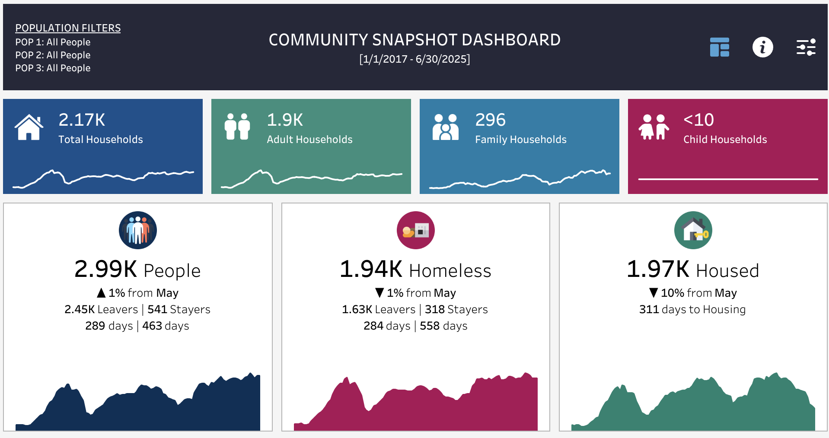
Example Data Dashboard
PCHO Community Snapshot Dashboard
Notes:
Dashboards like this one turn static reports into living mirrors.
In homelessness and housing, they let you see what’s happening now — not just last year. Every color and shape on this dashboard is a window into equity: who’s being served, who isn’t, and where resources are unevenly distributed. These visuals help communities respond faster and more fairly.
How many people use some sort of dashboard in their organization?
Many organizations use visualizations organized into dashboards, but why? Isn't a spreadsheet with raw numbers better? Let's find out!
###END OF NOTE###

Slide 40

Anscombe’s Quartet
Numbers can mislead
Four datasets share the same stats
Do they really tell the same story?
Notes:
Sometimes the numbers look clear — until you really look.
Anscombe’s Quartet is a classic example of why averages lie. Four datasets, all with identical summary stats — same means, same correlations — yet completely different shapes once graphed.
It’s a reminder that surface-level “success” metrics, like overall housing rates, can hide racial disparities underneath.
###END OF NOTE###

Slide 41
Anscombe’s Quartet Data Table
I |  | II |  | III |  | IV
x | y | x | y | x | y | x | y
10 | 8.04 | 10 | 9.14 | 10 | 7.46 | 8 | 6.58
8 | 6.95 | 8 | 8.14 | 8 | 6.77 | 8 | 5.76
13 | 7.58 | 13 | 8.74 | 13 | 12.74 | 8 | 7.71
9 | 8.81 | 9 | 8.77 | 9 | 7.11 | 8 | 8.84
11 | 8.33 | 11 | 9.26 | 11 | 7.81 | 8 | 8.47
14 | 9.96 | 14 | 8.10 | 14 | 8.84 | 8 | 7.04
6 | 7.24 | 6 | 6.13 | 6 | 6.08 | 8 | 5.25
4 | 4.26 | 4 | 3.10 | 4 | 5.39 | 19 | 12.50
12 | 10.84 | 12 | 9.13 | 12 | 8.15 | 8 | 5.56
7 | 4.82 | 7 | 7.26 | 7 | 6.42 | 8 | 7.91
5 | 5.68 | 5 | 4.74 | 5 | 5.73 | 8 | 6.89
Notes:
Looking only at tables, all four datasets appear identical.
That’s how many communities read their data — at the spreadsheet level. Everything looks fine. But hidden in those numbers might be the same story: white households housed faster, Black households waiting longer. Without visualizing, inequity hides behind averages.
###END OF NOTE###

Slide 42
Anscombe’s Quartet Summary Statistics
All 4 datasets have the exact same summary statistics:
mean of the x values = 9.0
mean of the y values = 7.5
equation of the least-squared regression line is: y = 3 + 0.5x
sums of squared errors (about the mean) = 110.0
regression sums of squared errors (variance accounted for by x) = 27.5
residual sums of squared errors (about the regression line) = 13.75
correlation coefficient = 0.82
coefficient of determination = 0.67
Notes:
Here’s the trap of summary stats. They look perfectly balanced — until you realize they’re not.
We do the same in housing reports: we publish averages that make outcomes look equitable when they aren’t.
Data without visualization gives us comfort, not clarity. And equity work depends on clarity.
###END OF NOTE###

Slide 43
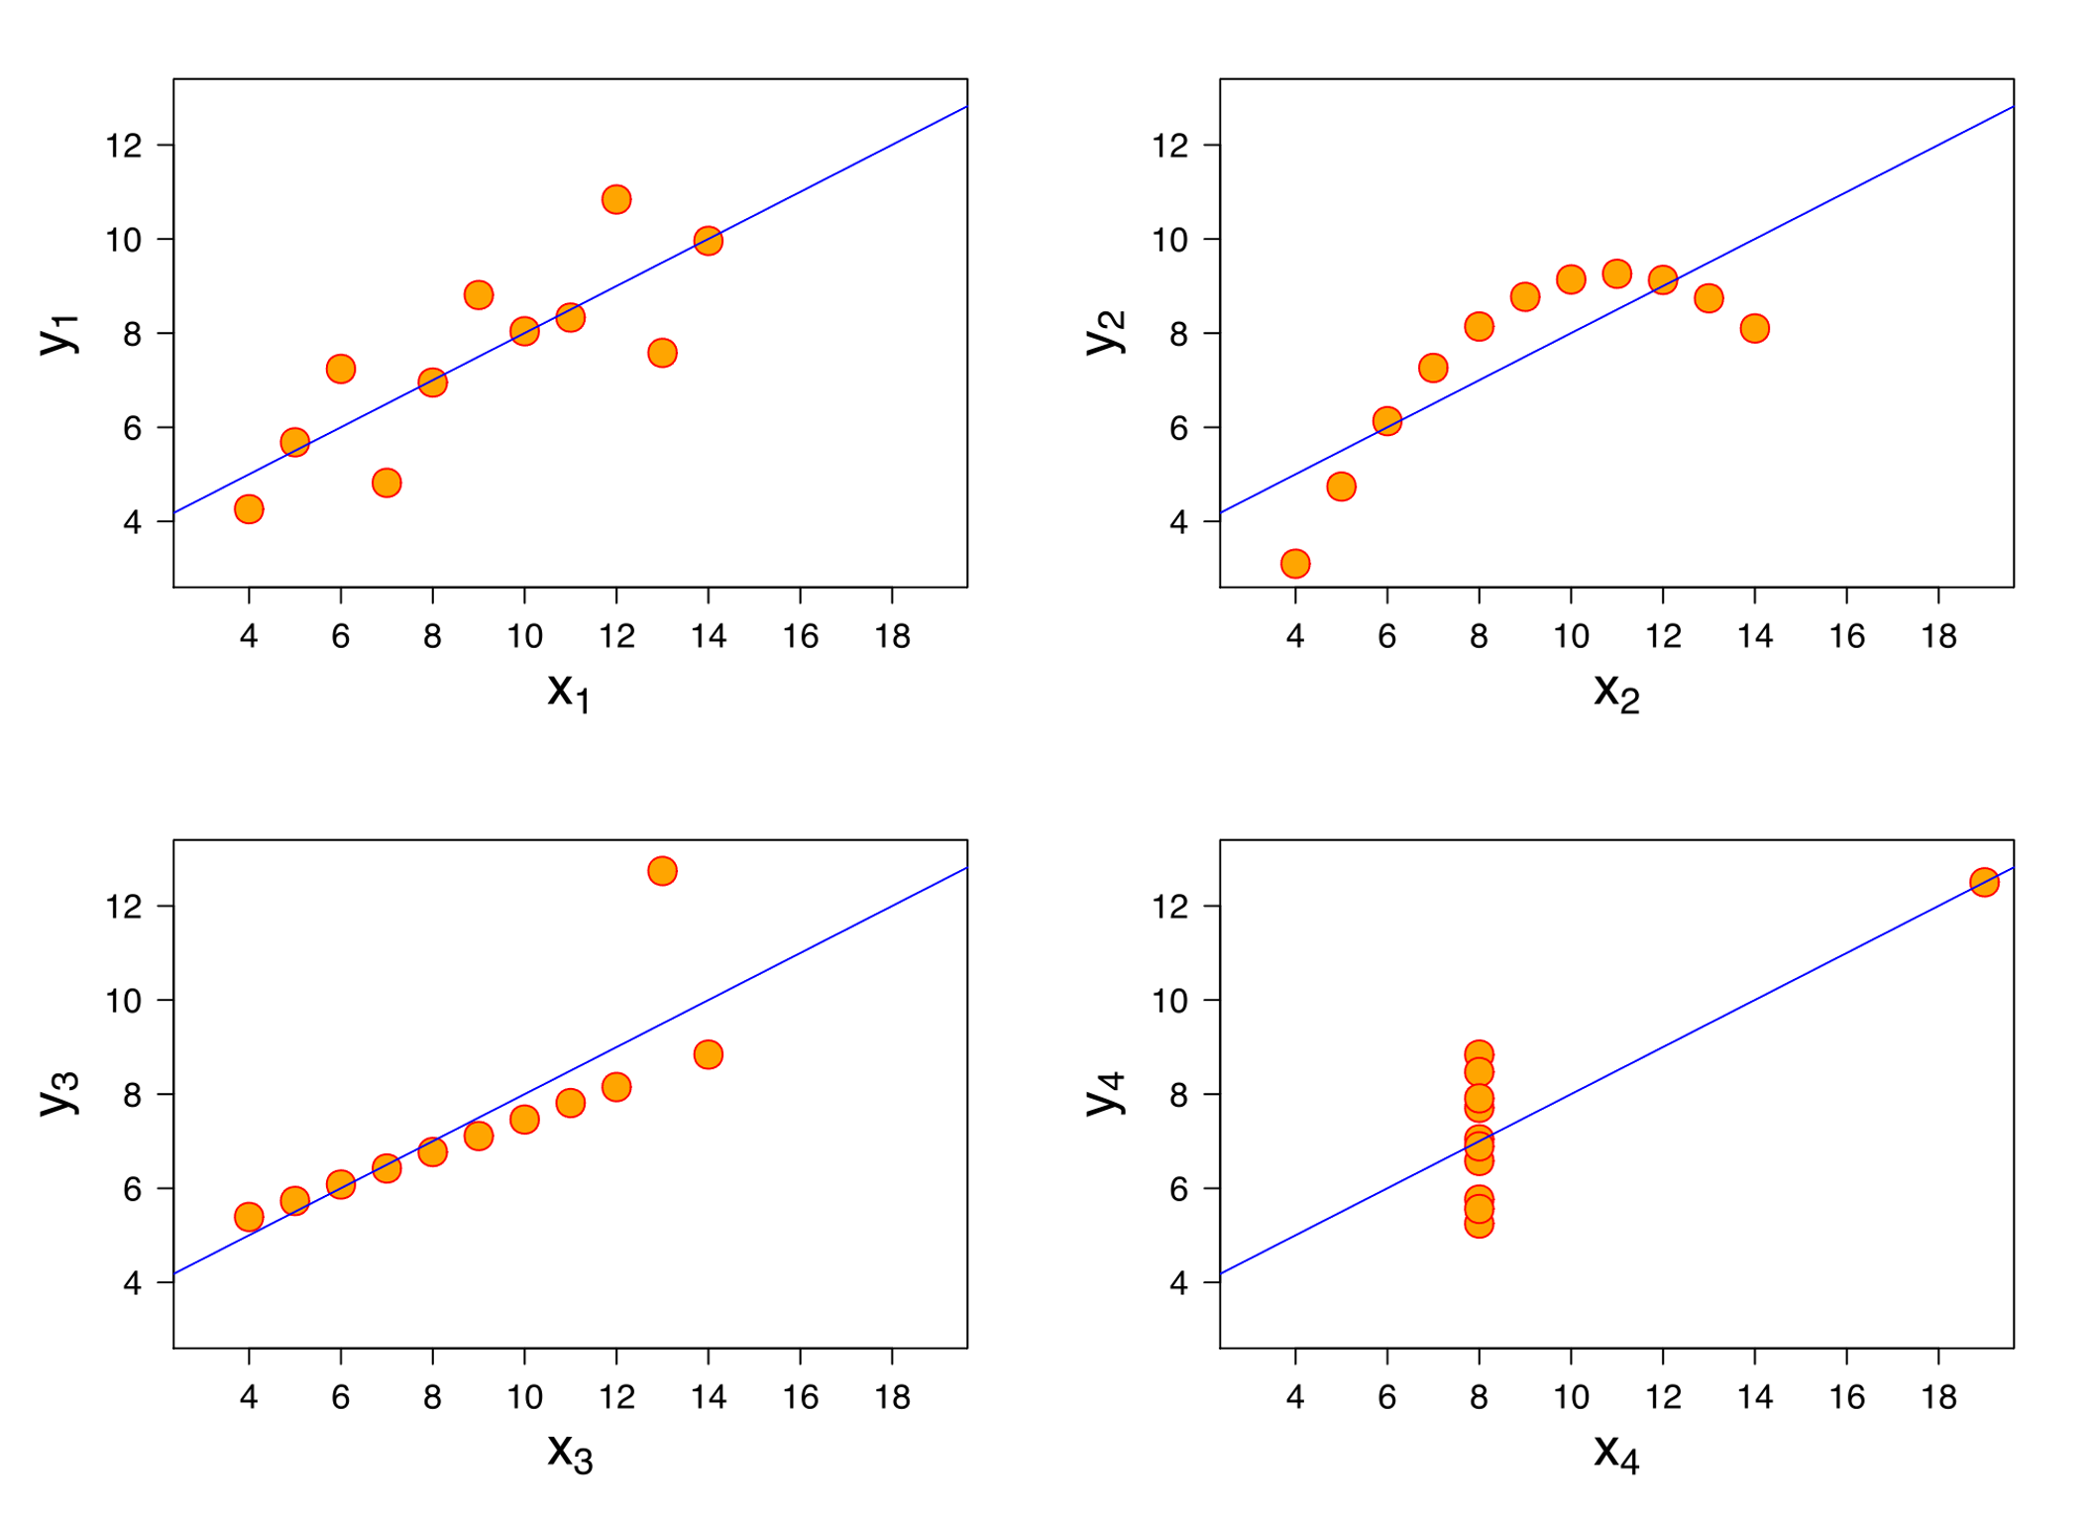
Anscombe’s Quartet Visualized
Notes:
Now look what happens when we graph the same data.
One dataset has a straight line, another curves, one’s dominated by an outlier.
In housing terms, that’s the difference between “everyone’s getting housed” and “everyone except one population.” Visualization and data analysis makes inequity visible. It’s how we find where the system is breaking down.
###END OF NOTE###

Slide 44
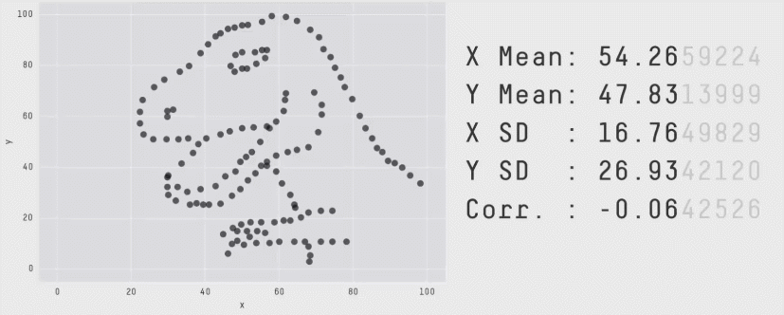
Datasaurus Rex & The Datasaurus Dozen
Notes:
Datasaurus Rex shows us that numbers can match perfectly on paper and still paint completely different pictures.
In equity work, that’s a dangerous illusion. We might see equal performance metrics across programs, but visuals reveal who’s being left behind. The lesson is simple: never trust averages. Always look at the shape of the story.
###END OF NOTE###

Slide 45
Visual Reporting Definitions
Visualization
KPI
Data Dashboard
Turns numbers into charts, graphs, maps
Makes patterns and outliers visible
Accessible to decision-makers and the public
Single value tracking progress on what matters most
Examples: exits to housing, length of time homeless, returns
Brings KPIs + visuals together in one place
Real-time, interactive, guides decisions
Turns static reports into living tools
Notes:
A chart or map shows patterns; KPIs quantify progress; dashboards tie them together.
In homelessness and housing, these tools show how inflow, exits, and returns differ by race — who’s cycling through, who’s stabilizing, and who’s falling through cracks we didn’t see.
When used together, they make equity actionable, not just aspirational.
###END OF NOTE###

Slide 46
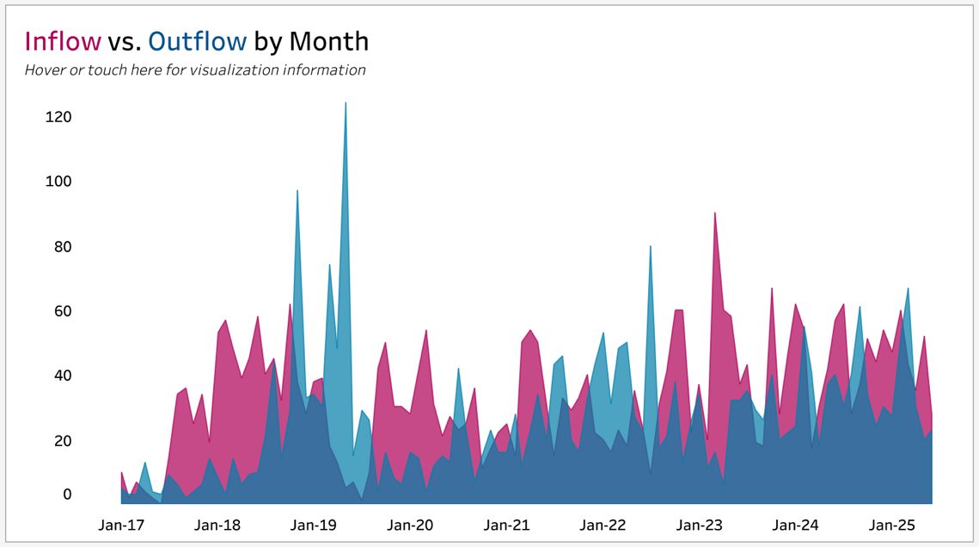
Visualization
Notes:
This graph shows inflow and outflow — who’s entering homelessness and who’s exiting to housing.
When we layer in race, we see something powerful: disparities in speed, stability, and returns.
Visualization takes what would be invisible in a report and turns it into an undeniable pattern.
It helps leaders ask, “Who is falling behind, and why?”
###END OF NOTE###

Slide 47
Visualizing Apples
Imagine we collect apples for 1 week and we want to know which day was our best day and which was our worst. Here’s a table with how many apples we collected each day.
Mon | Tue | Wed | Thu | Fri | Sat | Sun
3 | 1 | 2 | 2 | 0 | 6 | 13
Notes:
Raw data is like this table — technically complete, but hard to interpret.
You can see the numbers, but the story is buried.
That’s what homelessness data looks like before visualization: lines and columns that don’t reveal who’s thriving and who’s struggling.
###END OF NOTE###

Slide 48

Visualizing Apples
Imagine we collect apples for 1 week and we want to know which day was our best day and which was our worst. Here’s a table with how many apples we collected each day.
Which day had the most apples collected?
Which day had the least apples collected?
Mon | Tue | Wed | Thu | Fri | Sat | Sun
3 | 1 | 2 | 2 | 0 | 6 | 13
Notes:
When we visualize, the story starts to appear.
Now we can see peaks and valleys — patterns we couldn’t spot before.
In housing, those “peaks” are often moments of progress, and the “valleys” are where racial inequities widen.
Visualization is how we stop guessing and start understanding.
###END OF NOTE###

Slide 49
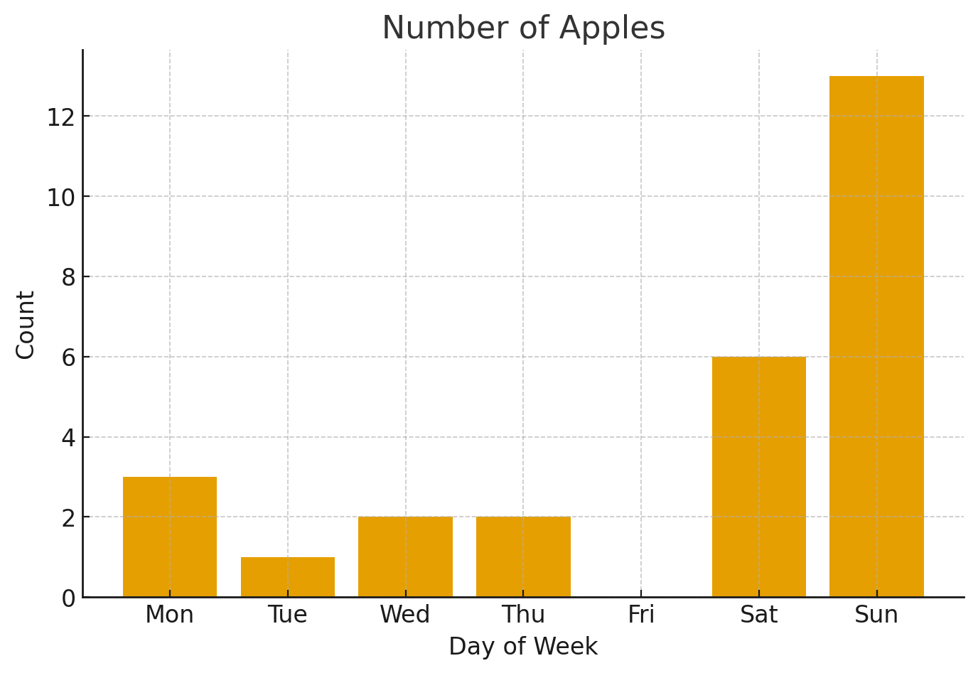
Visualizing Apples
Here’s what a polished visualization might look like. The height of the bar is a simple representation of how many apples were collected each day of the week.
Notes:
Once we polish the data into a bar chart, the story becomes obvious.
One glance and you can see the difference — highs, lows, trends.
It’s the same with homelessness dashboards: we can instantly see which projects, populations, or policies are working and which aren’t.
Good visuals don’t just inform — they compel action.
###END OF NOTE###

Slide 50
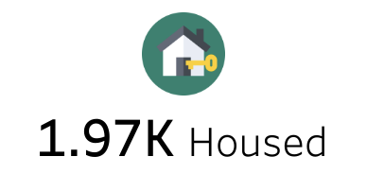
Key Performance Indicators (KPI’s)
Notes:
KPIs are the pulse points of a system.
They tell us whether we’re moving in the right direction — toward stability or away from it.
In homelessness work, KPIs like housing placements, time homeless, and returns show where equity is succeeding and where it’s slipping.
But KPIs alone aren’t the story — they’re the heartbeat. The dashboard is the body that gives it life.
###END OF NOTE###

Slide 51
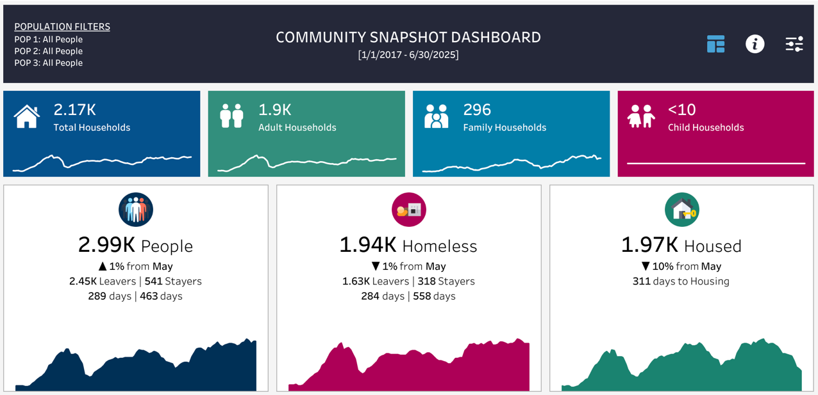
Data Dashboard
Notes:
This is where the heartbeat turns into vision.
Dashboards combine data and visualization into one living tool.
Leaders can see trends, staff can spot bottlenecks, and the public can understand outcomes without translation.
Dashboards are what turn transparency into trust — and trust into progress.
###END OF NOTE###

Slide 52
2 Types of Data Dashboards
Explanatory
Exploratory
Clear story about performance
Highlights KPIs, compares to targets
Communication tool for quick decisions
Built for discovery
Filter, drill down, test questions
Supports curiosity, analysis, problem-solving
Notes:
There are two kinds of dashboards: explanatory and exploratory.
Explanatory tells the clear, top-level story — “how are we doing?”
Exploratory digs deeper — “why are we seeing this?”
In equity work, we need both. One to communicate progress to the public, and one to expose patterns that keep inequity alive beneath the surface.
###END OF NOTE###

Slide 53
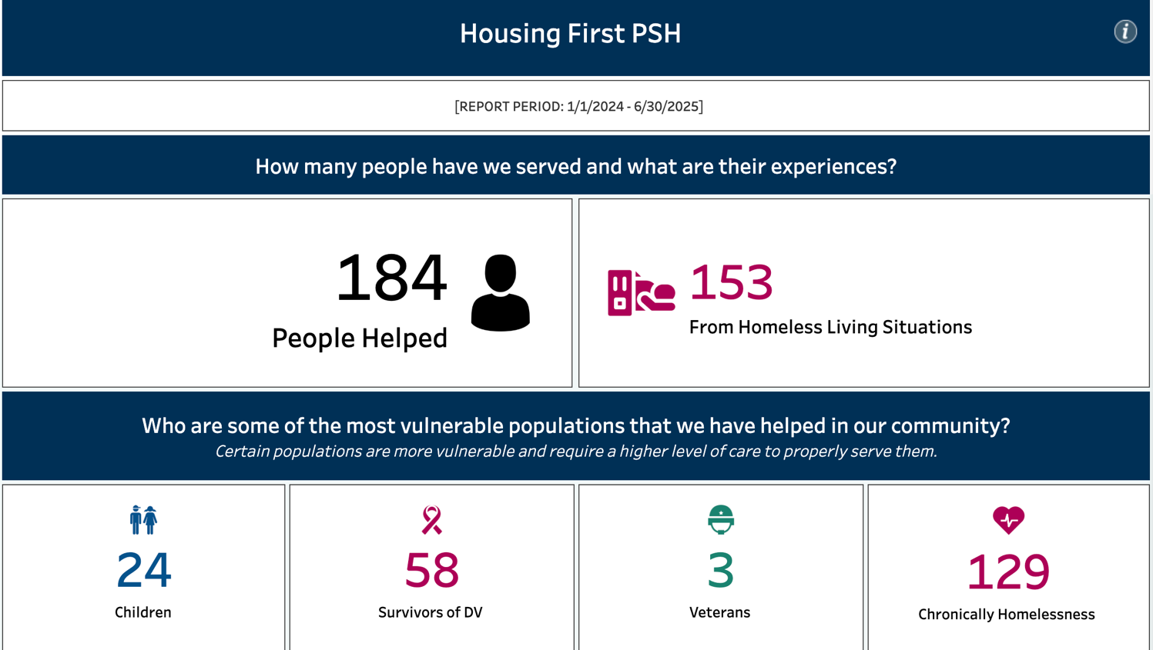
Explanatory Dashboard Example
Community Analysis Dashboard
Notes:
Here’s an explanatory dashboard.
It answers one clear question: how are we doing right now?
It focuses on the big picture — people housed, exits from homelessness, key populations served.
In equity work, this is how we communicate with clarity. It tells the story quickly so leaders and funders can focus on solutions instead of searching for data.
###END OF NOTE###

Slide 54
Exploratory Dashboard Example
Community Equity Dashboard
Notes:
This one digs deeper.
It’s built for discovery — you can filter by race, age, population type, or time period.
You can explore patterns in chronic homelessness, returns, or child homelessness.
Exploratory dashboards turn curiosity into insight. They help practitioners uncover what’s driving inequity — and where to act next.
###END OF NOTE###

Slide 55
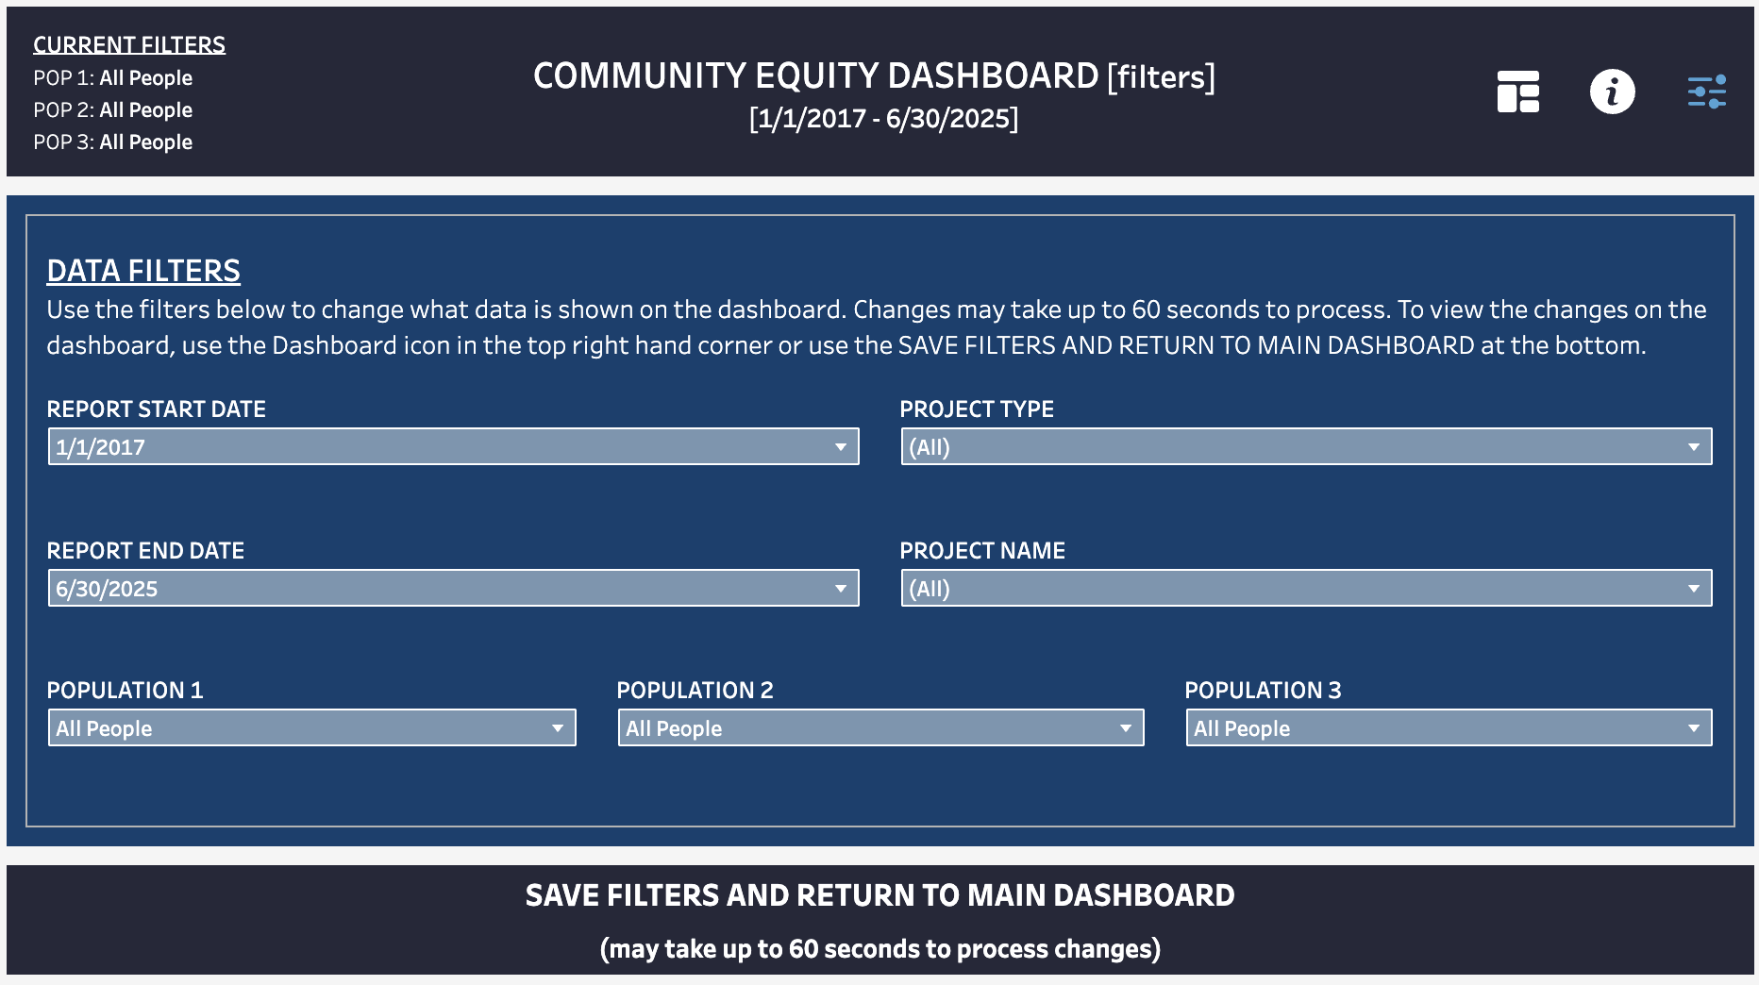
PCHO Racial Equity Dashboard
GaitherDyn.com/equity
Notes:
This is what exploration looks like in action.
You can drill down, compare, and layer different filters.
It doesn’t tell a single story — it helps you find many stories inside the same data.
In housing equity, this matters because disparities don’t always appear at the surface; they hide in intersections — race and age, gender and disability, income and access.
###END OF NOTE###

Slide 56

Life Demo: Equity in Action
Follow along at GaitherDyn.com/equity
Notes:
Now we get to see it in motion.
In this demo, you’ll see exactly how the Racial Equity Dashboard works — showing homelessness, housing, chronic homelessness, and returns side by side by race.
We’ve spent the first part of this talk building the “why.” This is the “how.”
###END OF NOTE###

Slide 57
Questions?
Ask away!
Notes:
This is the part I look forward to most — hearing what stood out to you.
Questions are where insight gets personal.
Equity isn’t a destination; it’s a conversation.
###END OF NOTE###

Slide 58
Thanks!
Do you have any questions?
Gaither.Stephens@GaitherDyn.com
GaitherDyn.com
CoCAlliance.org
Notes:
Thank you all for being part of this and for your time and attention today.
If we take one thing away today, let it be this: inequity leaves evidence.
When we use data honestly, we can see that evidence and design something better — together.
We can’t fix what we won’t face — but once we see it, change becomes inevitable.
Thank you again!
###END OF NOTE###

